Slide 1

WooCommerce
COURSE SLIDES · WSQ
Building a Successful eCommerce Store with WooCommerce
WSQ Course Code: TGS-2026064474
Conducted by Tertiary Infotech Academy Pte Ltd · UEN 201200696W
Version v15.0 · 10 August 2026
© 2026 Tertiary Infotech Academy Pte Ltd. All rights reserved. · www.tertiarycourses.com.sg

Slide 2
COURSE ADMINISTRATION
Welcome & Housekeeping
Building a Successful eCommerce Store with WooCommerce · TGS-2026064474
© 2026 Tertiary Infotech Academy Pte Ltd
2

Slide 3
TRAQOM · SSG DIGITAL ATTENDANCE
Digital Attendance (Mandatory)
1
2
3
▶
▶
MORNING (AM)
Scan on arrival
AFTERNOON (PM)
Scan after lunch
ASSESSMENT
Scan before you begin
Building a Successful eCommerce Store with WooCommerce · TGS-2026064474
© 2026 Tertiary Infotech Academy Pte Ltd
3

Slide 4
TRAQOM · SSG DIGITAL ATTENDANCE
How Digital Attendance Works
Mandatory for WSQ funding
AM, PM and Assessment attendance must all be taken on the training day.
The QR code
The trainer or administrator displays the QR code generated from the SSG portal.
1
2
How to submit
Scan the QR code with your mobile phone camera and submit your attendance.
75% minimum
At least 75% attendance is required to be eligible for assessment and funding.
3
4
Building a Successful eCommerce Store with WooCommerce · TGS-2026064474
© 2026 Tertiary Infotech Academy Pte Ltd
4

Slide 5
YOUR TRAINER · GENERAL
About the Trainer
NAME
____________________________________________
?
TITLE / DESIGNATION
____________________________________________
QUALIFICATIONS
____________________________________________
Your Trainer
AREAS OF EXPERTISE
____________________________________________
General Trainer template —
to be completed by the trainer
TRAINING & INDUSTRY EXPERIENCE
____________________________________________
CONTACT
____________________________________________
Building a Successful eCommerce Store with WooCommerce · TGS-2026064474
© 2026 Tertiary Infotech Academy Pte Ltd
5

Slide 6
YOUR TRAINER
About the Trainer
ROLE
Principal Trainer, Tertiary Infotech Academy Pte Ltd
AA
EXPERTISE
eCommerce, WordPress and WooCommerce content management systems.
Dr. Alfred Ang
DELIVERS
WSQ courses on eCommerce, web development, digital marketing and data analytics.
Principal Trainer
Tertiary Infotech Academy Pte Ltd
FOUNDER
Founder and lead instructor at Tertiary Infotech / Tertiary Courses.
Building a Successful eCommerce Store with WooCommerce · TGS-2026064474
© 2026 Tertiary Infotech Academy Pte Ltd
6

Slide 7
ICE-BREAKER
Let's Know Each Other
Who you are
Your name, your organisation and the role you play there.
1
What you've used
Your experience with WordPress, eCommerce or running an online store.
2
What you'll sell
One product or business you would like to sell online by the end of today.
3
Building a Successful eCommerce Store with WooCommerce · TGS-2026064474
© 2026 Tertiary Infotech Academy Pte Ltd
7

Slide 8
HOUSEKEEPING
Ground Rules
Set your mobile phone to silent mode.
Participate actively — no question is too small.
1
2
Mutual respect: agree to disagree.
One conversation at a time.
3
4
Be punctual; return from breaks on time.
75% attendance is required.
5
6
Building a Successful eCommerce Store with WooCommerce · TGS-2026064474
© 2026 Tertiary Infotech Academy Pte Ltd
8

Slide 9
BEFORE WE START
Prerequisite
Basic WordPress
Basic WordPress operation is assumed in this course.
Comfortable with a browser
You can navigate a WordPress admin dashboard and upload an image.
1
2
A store to build
Bring a product idea — you will build a real catalogue around it today.
No coding required
Everything in this course is done through the WooCommerce interface.
3
4
Building a Successful eCommerce Store with WooCommerce · TGS-2026064474
© 2026 Tertiary Infotech Academy Pte Ltd
9

Slide 10
COURSE PORTAL
Download Your Course Material
🔒 lms-tms.tertiaryinfotech.com
Go to lms-tms.tertiaryinfotech.com
Open the portal in any browser.
1
Tertiary Infotech · LMS / TMS
Log in with your registered email
The same address used to enrol.
2
MY COURSES
Building a Successful eCommerce Store with WooCommerce
TGS-2026064474
Open this course
Building a Successful eCommerce Store with WooCommerce.
3
PDF
Learner Slides
⤓ Download
Download the material
Slides, Learner Guide and Lesson Plan.
4
PDF
Learner Guide
⤓ Download
Lesson Plan
Keep them open in class
The assessment is open book.
PDF
⤓ Download
5
Building a Successful eCommerce Store with WooCommerce · TGS-2026064474
© 2026 Tertiary Infotech Academy Pte Ltd
10

Slide 11
SKILLS FRAMEWORK
Skills Framework — TSC
TSC Title
Content Management System Utilisation
TSC Code
RET-CIE-4002-1.1
1
2
Sector
Retail
Proficiency
Level 4 — Manage the utilisation of content management systems to create, curate and publish web content, measure performance and recommend improvements.
3
4
Building a Successful eCommerce Store with WooCommerce · TGS-2026064474
© 2026 Tertiary Infotech Academy Pte Ltd
11

Slide 12
WHAT THIS COURSE DEVELOPS · A1–A3
TSC Abilities — Assessed by the Practical Performance
A1
Monitor adherence to content management policies, guidelines and permissions on content management
1
A2
Develop and review metrics to measure performance of content management systems
2
A3
Recommend areas for improvements for a better customer experience in terms of organisation's web properties and assets
3
Building a Successful eCommerce Store with WooCommerce · TGS-2026064474
© 2026 Tertiary Infotech Academy Pte Ltd
12

Slide 13
WHAT THIS COURSE DEVELOPS · A4–A6
TSC Abilities — Assessed by the Practical Performance (cont.)
A4
Ensure smooth maintenance and consistent updates of content management systems
1
A5
Highlight and resolve issues related to content management systems
2
A6
Edit and curate web content
3
Building a Successful eCommerce Store with WooCommerce · TGS-2026064474
© 2026 Tertiary Infotech Academy Pte Ltd
13

Slide 14
WHAT THIS COURSE DEVELOPS · K1–K4
TSC Knowledge — Assessed by Oral Questioning
1
K1
Content management policies, guidelines and permissions on content management
2
K2
Web content for deployment
3
K3
Organisation's web properties and assets
4
K4
Creation and curation of web content guidelines
Building a Successful eCommerce Store with WooCommerce · TGS-2026064474
© 2026 Tertiary Infotech Academy Pte Ltd
14

Slide 15
WHAT THIS COURSE DEVELOPS · K5–K7
TSC Knowledge — Assessed by Oral Questioning (cont.)
K5
Web content and platform management systems
1
K6
Types of performance metrics of content management systems
2
K7
Criteria for evaluating metrics to measure performance of content management systems
3
Building a Successful eCommerce Store with WooCommerce · TGS-2026064474
© 2026 Tertiary Infotech Academy Pte Ltd
15

Slide 16
SCHEDULE · DAY 1 · 9:30am – 6:30pm
Lesson Plan — Day 1
Morning · 9:30am – 12:30pm
Afternoon · 1:30pm – 6:30pm
– Digital Attendance (AM) · Introductions
– Learning outcomes, outline & TSC briefing
– Topic 1: Overview of WooCommerce CMS (LO1)
– Lab 1: Set Up Your WooCommerce Store
– Topic 2: Manage Products (LO2, LO3)
– Lab 2: Create and Curate a Simple Product
– Lunch Break — 1 hour
– Digital Attendance (PM)
– Lab 3: Variable Product · Lab 4: Curate Catalogue
– Topic 3: Payments & Shipping (LO4) · Lab 5
– Topic 4: Manage Sales (LO5) · Lab 6
– Topic 5: Manage Performance (LO6) · Lab 7
– Course Feedback & TRAQOM Survey
– Final Assessment — PP (75 min) + OQ (15 min)
Building a Successful eCommerce Store with WooCommerce · TGS-2026064474
© 2026 Tertiary Infotech Academy Pte Ltd
16

Slide 17
WHAT YOU'LL ACHIEVE
Learning Outcomes
1
LO1 · Setup and monitor
Setup and monitor WooCommerce CMS to ensure adherence to guidelines and policies. (A1, K1)
2
LO2 · Edit and curate
Edit and curate product website on WooCommerce CMS. (A6, K2, K4)
3
LO3 · Maintain content
Maintain product web content on WooCommerce CMS. (A4, K2, K4)
4
LO4 · Payments & shipping
Recommend payment and shipping methods to improve customer experience. (A3, K3)
5
LO5 · Manage issues
Manage issues such as sales, out-of-stock and promotion. (A5, K5)
6
LO6 · Manage performance
Manage WooCommerce CMS performance. (A2, K6, K7)
Building a Successful eCommerce Store with WooCommerce · TGS-2026064474
© 2026 Tertiary Infotech Academy Pte Ltd
17

Slide 18
FIVE TOPICS · ONE DAY · SEVEN HANDS-ON LABS
Course Outline
1
Topic 1 — Overview of WooCommerce CMS
Setup, themes, widgets, shortcodes, settings, currency and tax.
2
Topic 2 — Manage Products
Product types, images, variations, categories, attributes, up-sells and CSV import.
3
Topic 3 — Payments & Shipping
Payment gateways, shipping zones, flat rate, free shipping and local pickup.
4
Topic 4 — Manage Sales
Orders, statuses, refunds, restocking, coupons and promotions.
5
Topic 5 — Manage Performance
Sales, customer and stock reports, dashboard widgets and Google Analytics.
Building a Successful eCommerce Store with WooCommerce · TGS-2026064474
© 2026 Tertiary Infotech Academy Pte Ltd
18

Slide 19
WHAT YOU'LL BUILD · https://woocommerce.com
Hands-On Labs on WooCommerce
Morning · Labs 1–2
Afternoon · Labs 3–5
Afternoon · Labs 6–7
• Set up your WooCommerce store
• Configure currency and tax
• Create your first product
• Build a variable product
• Curate the catalogue & CSV import
• Payments and shipping zones
• Orders, refunds and coupons
• Reports and dashboard widgets
• Google Analytics integration
Building a Successful eCommerce Store with WooCommerce · TGS-2026064474
© 2026 Tertiary Infotech Academy Pte Ltd
19

Slide 20
BEFORE YOU BEGIN
Briefing for Assessment
Place phones and other materials under the table or on the floor.
No photos or recording of assessment scripts.
1
2
No discussion during the assessment.
Use a black or blue pen for hard-copy assessments.
3
4
No liquid paper or correction tape.
Scripts are collected when the time is up.
5
6
Building a Successful eCommerce Store with WooCommerce · TGS-2026064474
© 2026 Tertiary Infotech Academy Pte Ltd
20

Slide 21
ASSESSMENT · 90 MINUTES TOTAL · END OF DAY
Final Assessment
Practical Performance — 75 min
Oral Questioning — 15 min
What you may use
• Build and manage a WooCommerce store
• Assesses abilities A1–A6
• Open book, done individually
• Open-ended questions, 1:1
• Assesses knowledge K1–K7
• Open book
• The course slides
• Your Learner Guide
• Approved materials only
• An appeal process is available
Building a Successful eCommerce Store with WooCommerce · TGS-2026064474
© 2026 Tertiary Infotech Academy Pte Ltd
21

Slide 22
ON ASSESSMENT DAY
Assessment Flow
1
2
3
4
5
6
▶
▶
▶
▶
▶
TRAQOM survey — scan the QR code on the LMS
Assessment digital attendance — scan the SSG QR
Complete the Practical Performance — 75 min
Answer the Oral Questioning — 15 min, 1:1
Submit your work as directed
Sign the Assessment Summary Record
Building a Successful eCommerce Store with WooCommerce · TGS-2026064474
© 2026 Tertiary Infotech Academy Pte Ltd
22

Slide 23
WSQ FUNDING REQUIREMENTS
Criteria for Funding
Attendance
Minimum attendance rate of 75% based on the SSG Digital Attendance record.
Assessment
Complete the assessment and be assessed as 'Competent'.
1
2
Digital attendance
AM, PM and Assessment attendance must all be taken.
TRAQOM survey
Complete the mandatory feedback survey on the LMS.
3
4
Building a Successful eCommerce Store with WooCommerce · TGS-2026064474
© 2026 Tertiary Infotech Academy Pte Ltd
23

Slide 24
1
DAY 1
Building, Running and Measuring a WooCommerce Store
Topics 1–5 · Seven hands-on labs · Final assessment
Building a Successful eCommerce Store with WooCommerce · TGS-2026064474
© 2026 Tertiary Infotech Academy Pte Ltd
24

Slide 25
01
TOPIC 1
Overview of WooCommerce CMS
What WooCommerce is · Setup wizard · Themes · Widgets & shortcodes · Settings, currency & tax
Building a Successful eCommerce Store with WooCommerce · TGS-2026064474
© 2026 Tertiary Infotech Academy Pte Ltd
25

Slide 26
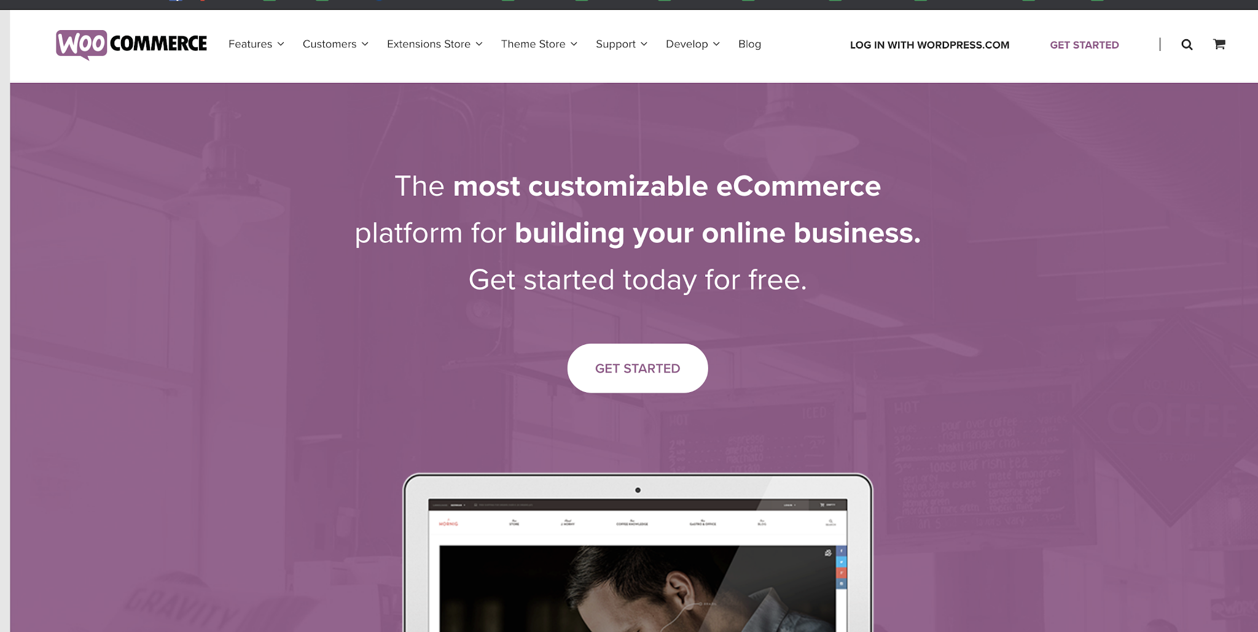
TOPIC 01 · CONTEXT
What is WooCommerce
WooCommerce is an open-source, fully customisable eCommerce platform built on WordPress.
Building a Successful eCommerce Store with WooCommerce · TGS-2026064474
© 2026 Tertiary Infotech Academy Pte Ltd
26

Slide 27
THE OPPORTUNITY
Why WooCommerce
Open source
Free to use, fully customisable, and owned by you — not rented from a hosted platform.
Built on WordPress
Runs on the world's most widely used CMS, so your shop and your content live together.
1
2
Every product type
Physical, digital, virtual, variable, subscription and bookable products.
Endlessly extensible
Hundreds of themes, payment gateways and extensions, plus a full developer API.
3
4
Building a Successful eCommerce Store with WooCommerce · TGS-2026064474
© 2026 Tertiary Infotech Academy Pte Ltd
27

Slide 28
TOPIC 01 · WHAT YOU'LL LEARN
Key Concepts in This Topic
What WooCommerce is
An open-source, fully customisable eCommerce platform built on WordPress, powering a large share of the world's online stores.
Six steps to a store
Choose hosting, install WordPress, pick a theme, activate WooCommerce, run the setup wizard, then extend with plugins.
1
2
System requirements
PHP 7.2+, MySQL 5.6+ or MariaDB 10.0+, a 128 MB WordPress memory limit, and HTTPS support.
Taxonomies and post types
WooCommerce adds its own post types and taxonomies to WordPress to group and structure products.
3
4
Themes and widgets
The theme sets the storefront's look; widgets surface products, filters and categories in widgetised areas.
Settings, currency and tax
General, Products, Tax, Shipping, Payments and Privacy settings define how the store behaves and prices goods.
5
6
Building a Successful eCommerce Store with WooCommerce · TGS-2026064474
© 2026 Tertiary Infotech Academy Pte Ltd
28

Slide 29

TOPIC 01 · INSPIRATION
WooCommerce Store Showcases
Real stores built on WooCommerce — https://woocommerce.com/showcase/
Building a Successful eCommerce Store with WooCommerce · TGS-2026064474
© 2026 Tertiary Infotech Academy Pte Ltd
29

Slide 30
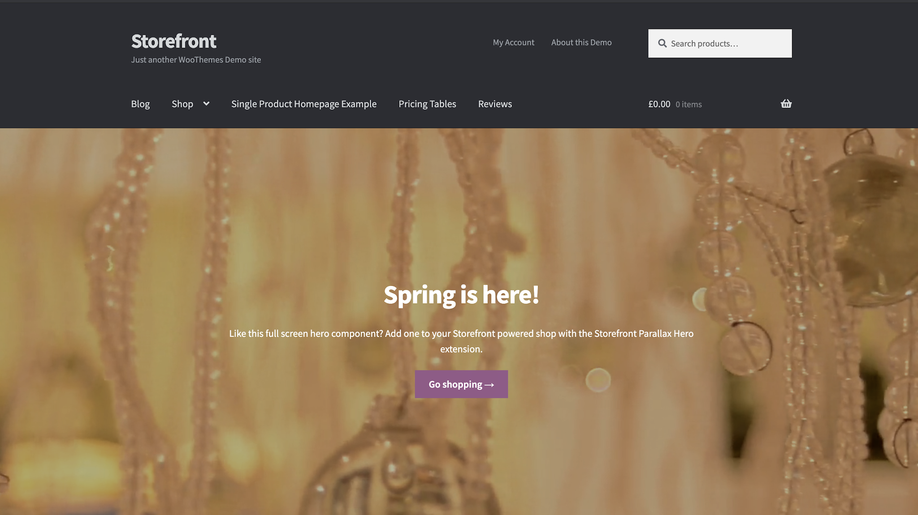
TOPIC 01 · INSPIRATION
WooCommerce Demo Store
The Storefront demo — https://themes.woocommerce.com/storefront/
Building a Successful eCommerce Store with WooCommerce · TGS-2026064474
© 2026 Tertiary Infotech Academy Pte Ltd
30

Slide 31
TOPIC 01 · THE PATH
Start with WooCommerce in 6 Steps
1
2
3
4
5
6
▶
▶
▶
▶
▶
HOSTING
Meet the requirements
INSTALL WP
Set up WordPress
THEME
Pick Storefront
ACTIVATE
Install the plugin
SET UP
Run the wizard
EXTEND
Add plugins
Building a Successful eCommerce Store with WooCommerce · TGS-2026064474
© 2026 Tertiary Infotech Academy Pte Ltd
31

Slide 32
TOPIC 01 · BEFORE YOU INSTALL
System Requirements
PHP 7.2 or greater
The server-side language WordPress and WooCommerce run on.
MySQL 5.6+ / MariaDB 10.0+
The database that stores products, orders and customers.
1
2
Memory limit 128 MB+
WordPress needs headroom to process a catalogue and orders.
HTTPS support
Essential — you are handling payment and customer data.
3
4
Building a Successful eCommerce Store with WooCommerce · TGS-2026064474
© 2026 Tertiary Infotech Academy Pte Ltd
32

Slide 33
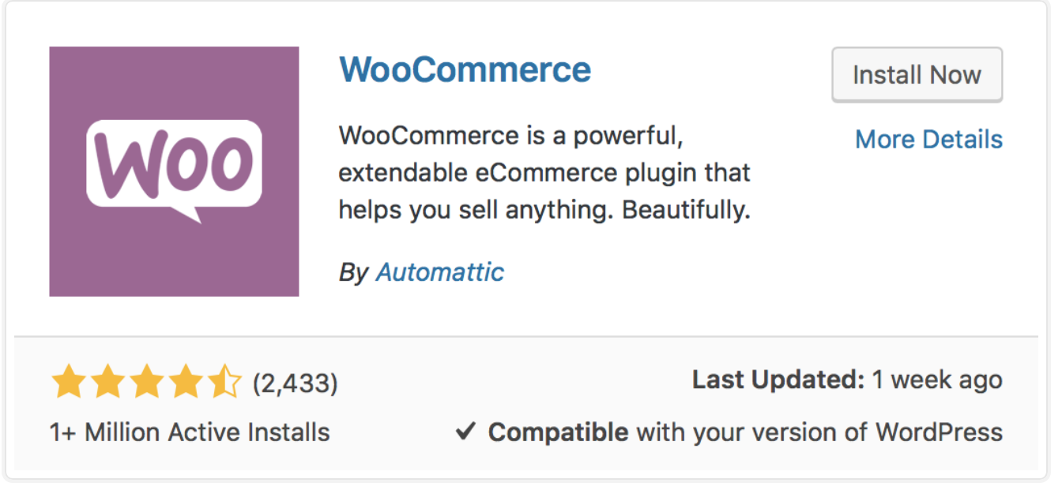
TOPIC 01 · INSTALL
Install WooCommerce
Plugins > Add New > search 'WooCommerce' by Automattic > Install Now > Activate.
Building a Successful eCommerce Store with WooCommerce · TGS-2026064474
© 2026 Tertiary Infotech Academy Pte Ltd
33

Slide 34
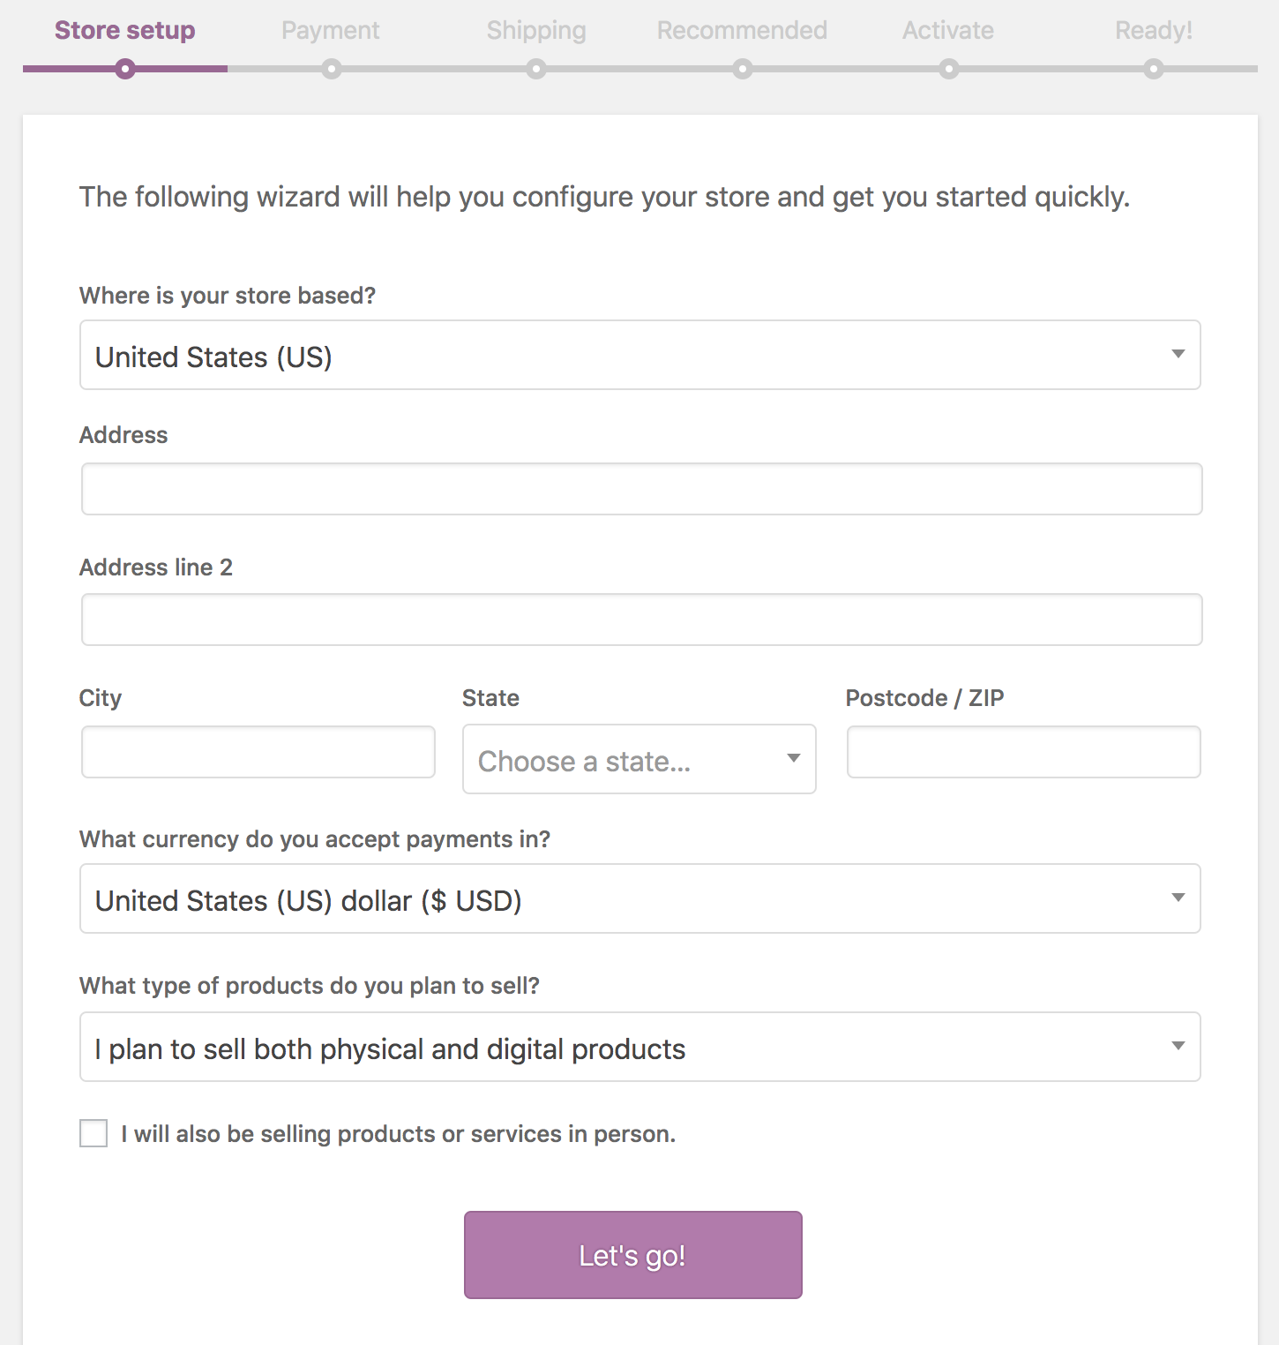
TOPIC 01 · INSTALL
The WooCommerce Setup Wizard
On first activation the Setup Wizard configures the store for you.
Building a Successful eCommerce Store with WooCommerce · TGS-2026064474
© 2026 Tertiary Infotech Academy Pte Ltd
34

Slide 35
TOPIC 01 · INSTALL
Store Setup
Location and currency, the type of goods you sell, and whether you sell in person.
Building a Successful eCommerce Store with WooCommerce · TGS-2026064474
© 2026 Tertiary Infotech Academy Pte Ltd
35

Slide 36
TOPIC 01 · HOW WOOCOMMERCE STRUCTURES CONTENT
Taxonomies and Post Types
Post types
WordPress separates content into types — posts, pages, attachments. WooCommerce adds 'product'.
Taxonomies
A grouping of post types — categories and tags. WooCommerce adds product categories, tags and attributes.
1
2
Why it matters
This structure is what lets you filter, browse and curate a catalogue rather than a pile of pages.
Created for you
The setup wizard registers these automatically when WooCommerce is activated.
3
4
Building a Successful eCommerce Store with WooCommerce · TGS-2026064474
© 2026 Tertiary Infotech Academy Pte Ltd
36

Slide 37
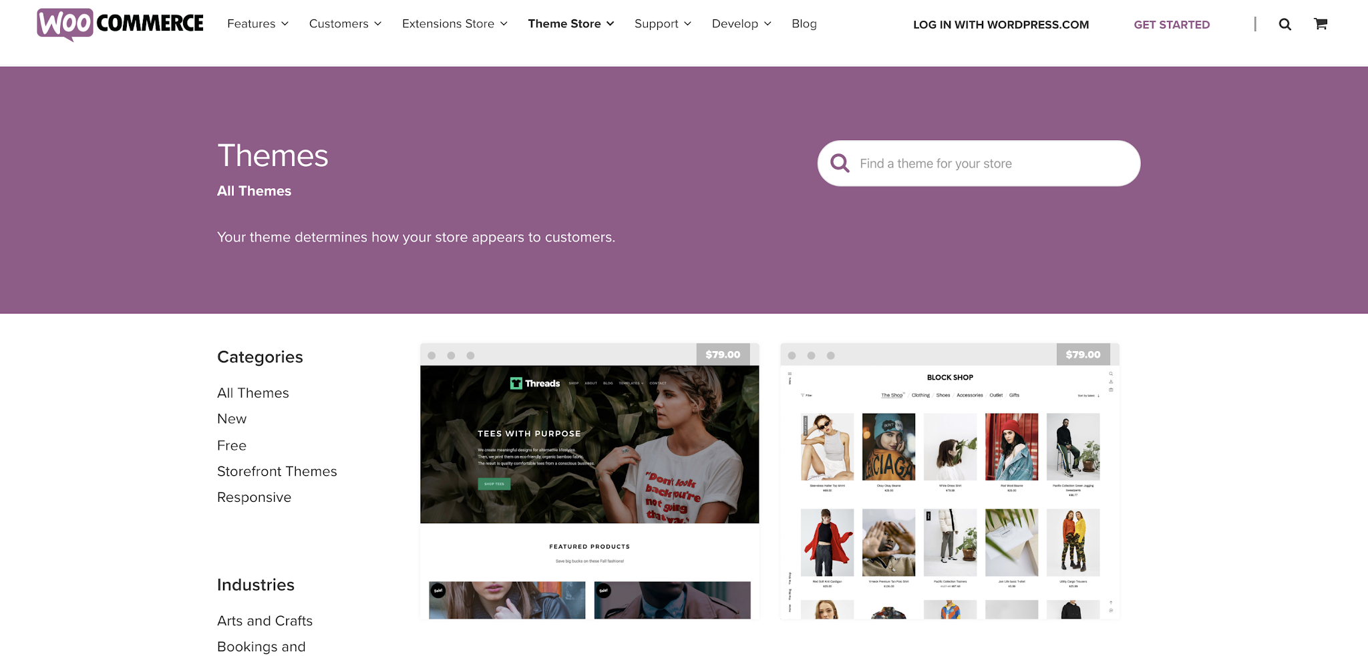
TOPIC 01 · THEMES
Professional WooCommerce Themes
Official themes — https://woocommerce.com/product-category/themes
Building a Successful eCommerce Store with WooCommerce · TGS-2026064474
© 2026 Tertiary Infotech Academy Pte Ltd
37

Slide 38
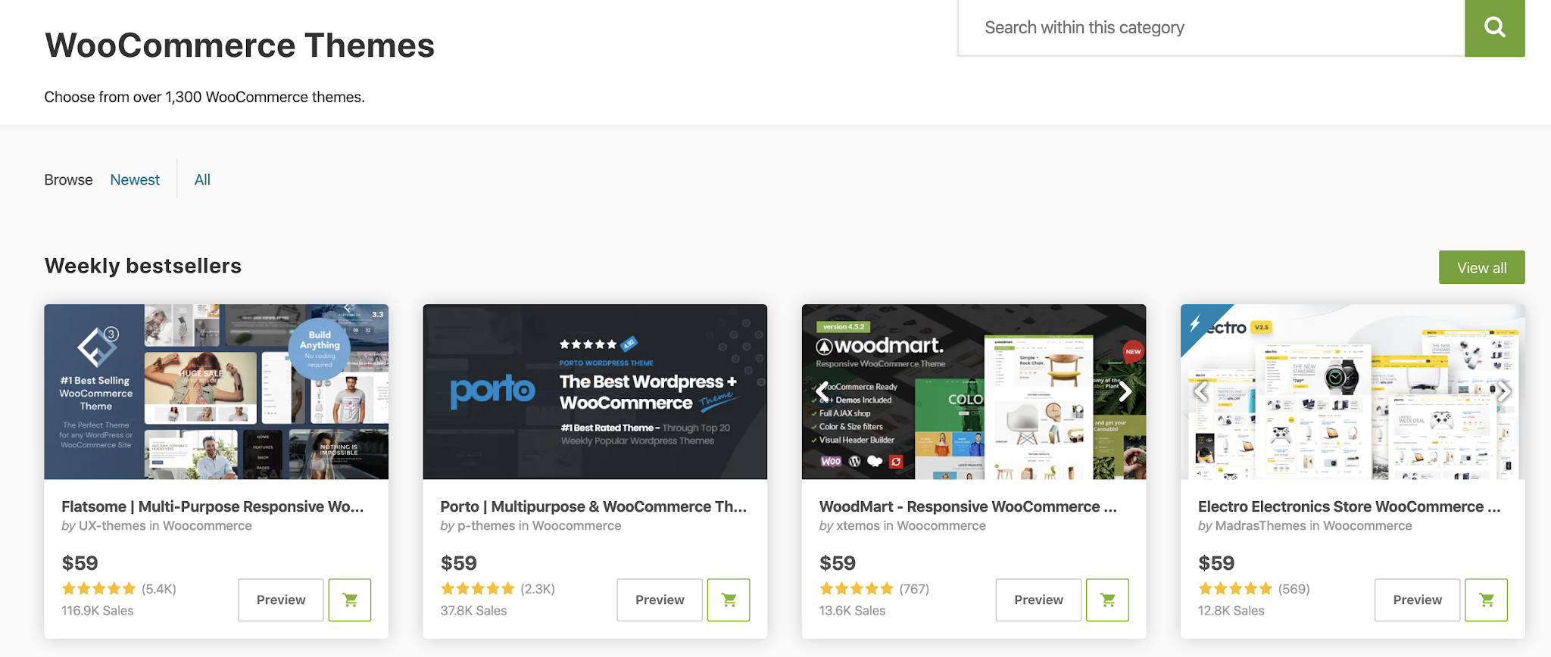
TOPIC 01 · THEMES
Third-Party WooCommerce Themes
ThemeForest — https://themeforest.net/category/wordpress/ecommerce/woocommerce
Building a Successful eCommerce Store with WooCommerce · TGS-2026064474
© 2026 Tertiary Infotech Academy Pte Ltd
38

Slide 39
TOPIC 01 · THEMES
Choosing the Right Theme
Aesthetic
Does it suit your brand and the products you sell?
Release frequency
An actively maintained theme keeps pace with WooCommerce updates.
1
2
Support
Is there documentation and a responsive support channel?
Custom functionality
What does it add beyond styling — and will that lock you in?
3
4
Responsive
It must work on a phone; most storefront traffic is mobile.
Compatibility
Confirm it declares WooCommerce support explicitly.
5
6
Building a Successful eCommerce Store with WooCommerce · TGS-2026064474
© 2026 Tertiary Infotech Academy Pte Ltd
39

Slide 40
TOPIC 01 · WIDGETS
WooCommerce Widgets
Product widgets
Products, Products by Rating, Recent Product Reviews, Recently Viewed Products.
Filter widgets
Filter by Attribute, Filter by Price, Filter by Rating, plus Active Product Filters.
1
2
Navigation widgets
Product Categories as a list or dropdown, and a Product Tag Cloud.
Utility widgets
Cart and Product Search, so customers can buy and find from any page.
3
4
Building a Successful eCommerce Store with WooCommerce · TGS-2026064474
© 2026 Tertiary Infotech Academy Pte Ltd
40

Slide 41
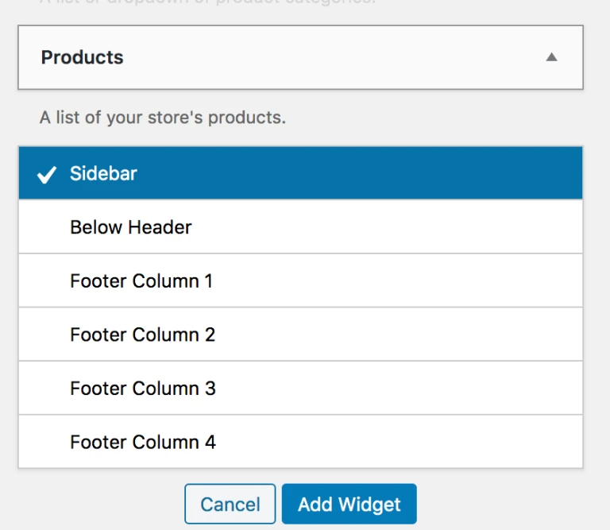
TOPIC 01 · WIDGETS
Adding a Widget
Appearance > Widgets — choose a widget area, then Add Widget.
Building a Successful eCommerce Store with WooCommerce · TGS-2026064474
© 2026 Tertiary Infotech Academy Pte Ltd
41

Slide 42
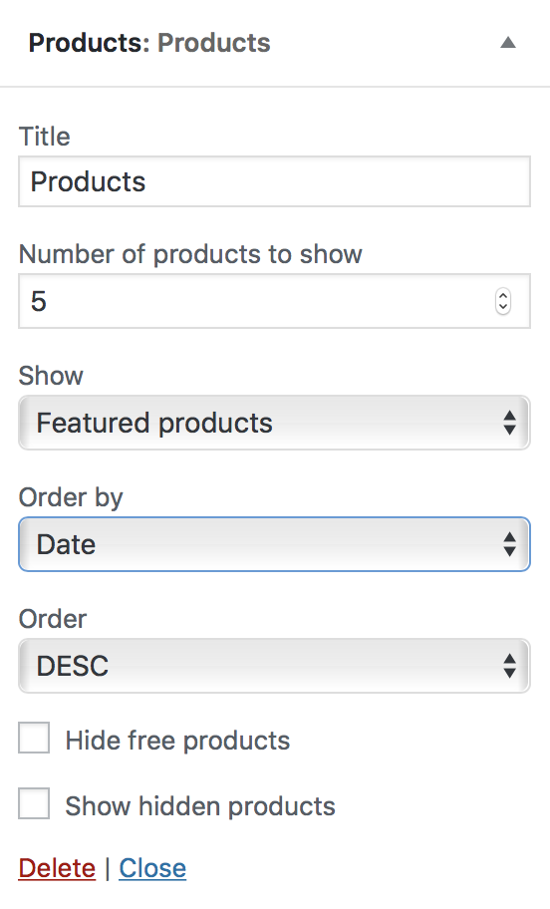
TOPIC 01 · WIDGETS
The Products Widget
Show products by date, price, sales or randomly — all, featured only, or on sale.
Building a Successful eCommerce Store with WooCommerce · TGS-2026064474
© 2026 Tertiary Infotech Academy Pte Ltd
42

Slide 43
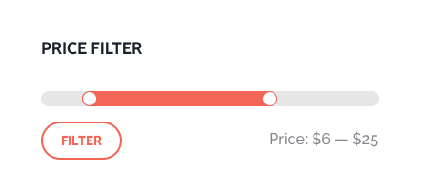
TOPIC 01 · WIDGETS
Filter Products by Price
A slider that auto-detects the minimum and maximum prices on the page.
Building a Successful eCommerce Store with WooCommerce · TGS-2026064474
© 2026 Tertiary Infotech Academy Pte Ltd
43

Slide 44
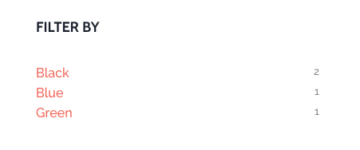
TOPIC 01 · WIDGETS
Filter Products by Attribute
Layered navigation — AND returns products matching both terms, OR matches either.
Building a Successful eCommerce Store with WooCommerce · TGS-2026064474
© 2026 Tertiary Infotech Academy Pte Ltd
44

Slide 45
TOPIC 01 · SHORTCODES — ADDED AUTOMATICALLY BY THE WIZARD
Shortcodes Included with WooCommerce
[woocommerce_cart]
Renders the cart page.
[woocommerce_checkout]
Renders the checkout page.
1
2
[woocommerce_my_account]
Renders the customer account page.
[woocommerce_order_tracking]
Renders the order tracking form.
3
4
Building a Successful eCommerce Store with WooCommerce · TGS-2026064474
© 2026 Tertiary Infotech Academy Pte Ltd
45

Slide 46
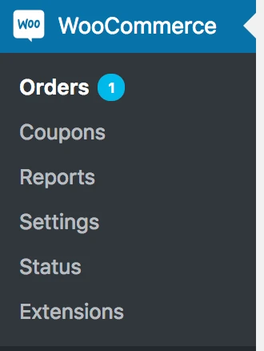
TOPIC 01 · THE ADMIN
WooCommerce Menu Items
Orders, Coupons, Reports and Settings — the four places you work every day.
Building a Successful eCommerce Store with WooCommerce · TGS-2026064474
© 2026 Tertiary Infotech Academy Pte Ltd
46

Slide 47
TOPIC 01 · WOOCOMMERCE > SETTINGS
Configuring WooCommerce Settings
General
Store address, selling and shipping locations, taxes and currency options.
Products
Shop pages, measurements, reviews, inventory and downloadable products.
1
2
Tax
Prices entered with tax, tax rates, and how tax is calculated and displayed.
Shipping
Shipping zones, methods, classes and shipping options.
3
4
Payments
Which gateways are enabled and the order they appear at checkout.
Accounts & Privacy
Guest checkout, account creation, and data retention policy.
5
6
Building a Successful eCommerce Store with WooCommerce · TGS-2026064474
© 2026 Tertiary Infotech Academy Pte Ltd
47

Slide 48
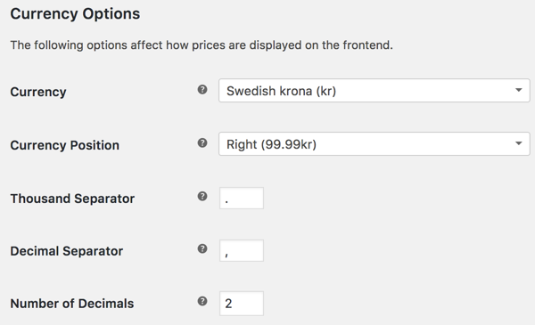
TOPIC 01 · SETTINGS
Shop Currency
WooCommerce > Settings > General > Currency options.
Building a Successful eCommerce Store with WooCommerce · TGS-2026064474
© 2026 Tertiary Infotech Academy Pte Ltd
48

Slide 49
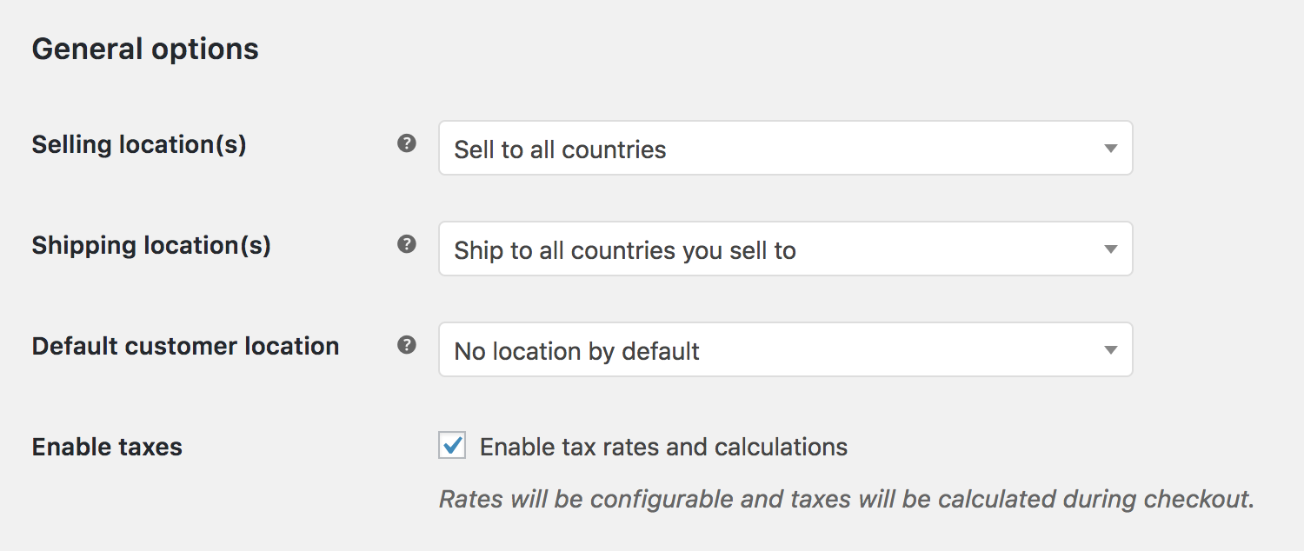
TOPIC 01 · TAX
Enabling Taxes
Tick 'Enable taxes and tax calculations' — the Tax tab then appears.
Building a Successful eCommerce Store with WooCommerce · TGS-2026064474
© 2026 Tertiary Infotech Academy Pte Ltd
49

Slide 50
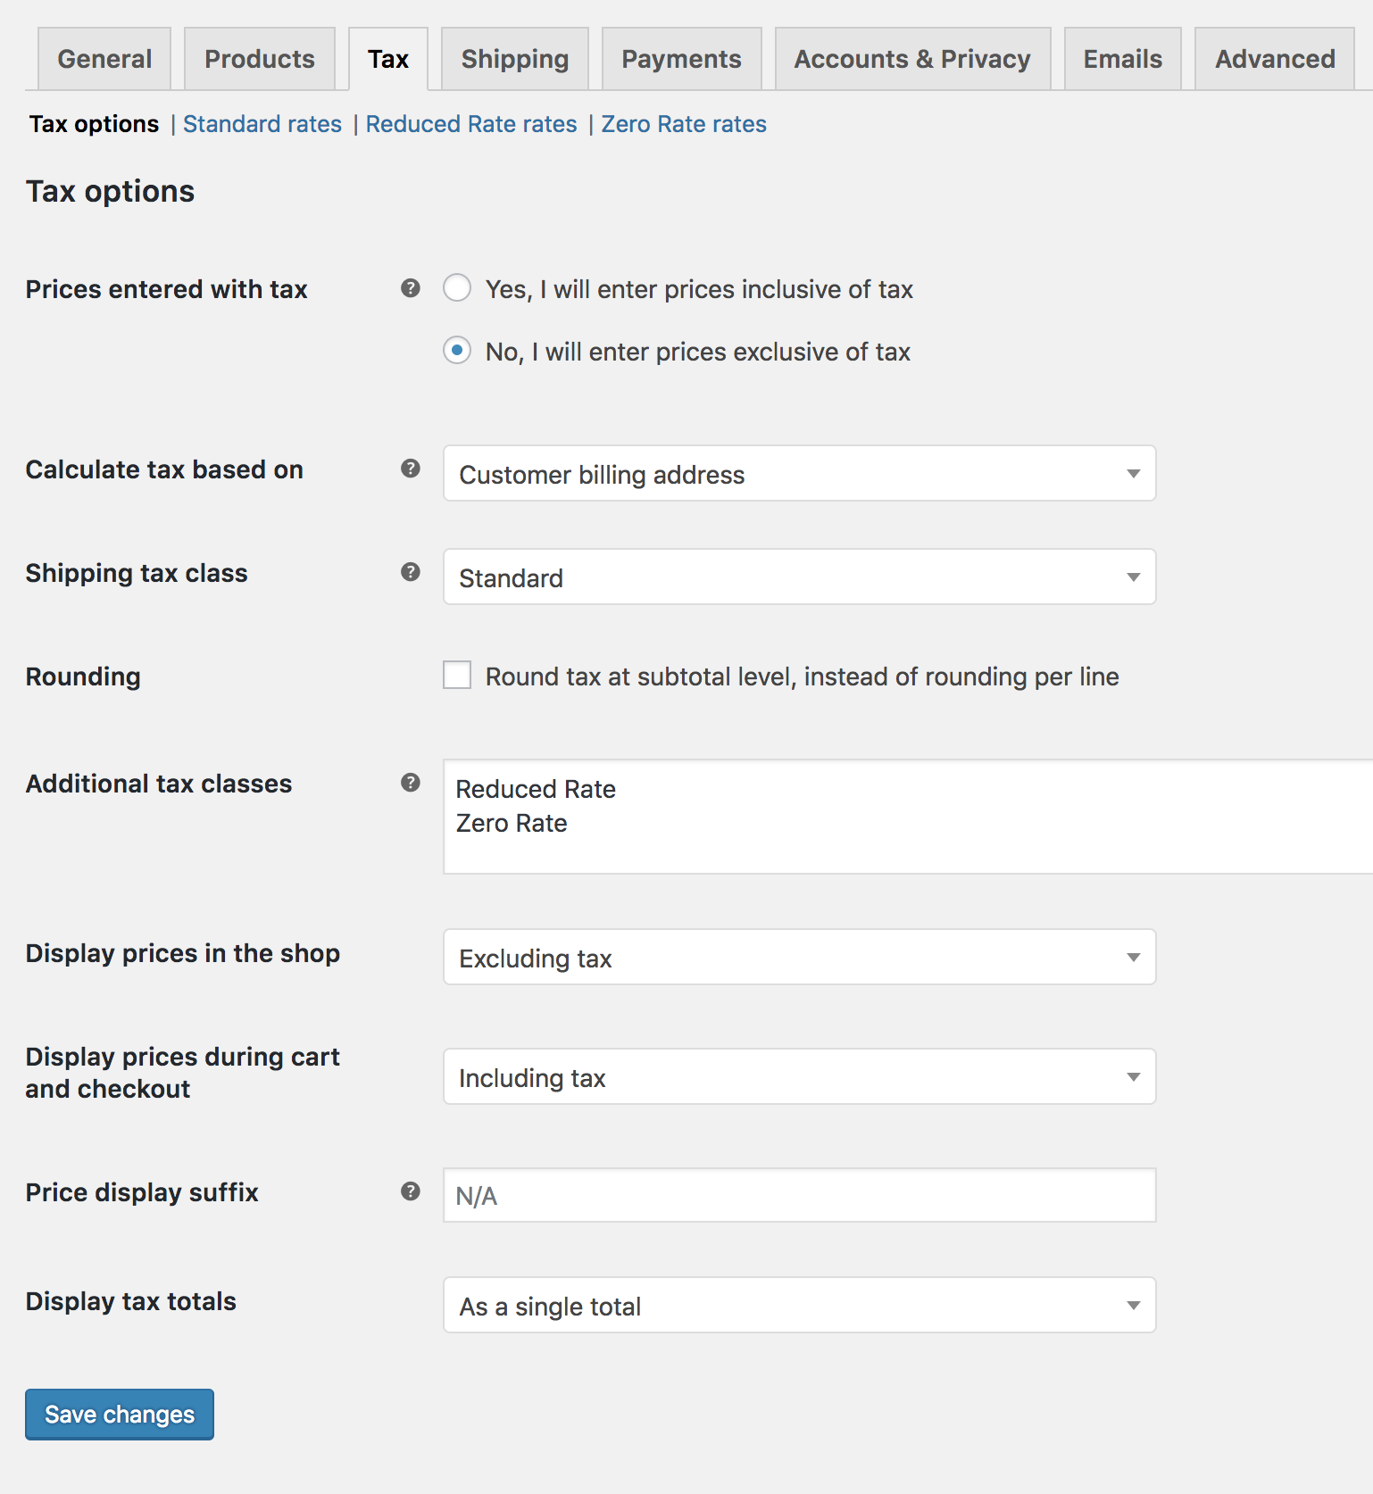
TOPIC 01 · TAX
Configuring Tax Options
WooCommerce > Settings > Tax — visible only once taxes are enabled.
Building a Successful eCommerce Store with WooCommerce · TGS-2026064474
© 2026 Tertiary Infotech Academy Pte Ltd
50

Slide 51
TOPIC 01 · THE MOST IMPORTANT TAX DECISION
Prices Entered With Tax
Inclusive
'Yes, I will enter prices inclusive of tax' — catalogue prices already contain the base tax rate.
Exclusive
'No, I will enter prices exclusive of tax' — tax is added on top at checkout.
1
2
Inclusive formula
tax_amount = price − ( price / ( ( tax_rate% / 100 ) + 1 ) )
Exclusive formula
tax_amount = price × ( tax_rate% / 100 )
3
4
Building a Successful eCommerce Store with WooCommerce · TGS-2026064474
© 2026 Tertiary Infotech Academy Pte Ltd
51

Slide 52
TOPIC 01 · HANDS-ON LAB
Set Up Your WooCommerce Store
LAB 1
Set up and monitor a WooCommerce CMS so it adheres to store guidelines and policies (A1, K1).
Install the WooCommerce plugin on a WordPress site, work through the setup wizard to define the store's location, currency and industry, then apply the Storefront theme and confirm the shop, cart, checkout and My Account pages have been created. You finish by setting the currency and tax options that every price in the store will follow.
YOU'LL BUILD
WHY THE BUSINESS CARES
A working WooCommerce store with its currency, tax and core pages configured
The setup wizard is where store-wide policy is set. Currency, tax treatment and page structure decide how every product is priced and presented — getting them right first avoids re-pricing an entire catalogue later.
TOOLS Plugins > Add New · WooCommerce Setup Wizard · Appearance > Themes · WooCommerce > Settings
Building a Successful eCommerce Store with WooCommerce · TGS-2026064474
© 2026 Tertiary Infotech Academy Pte Ltd
52

Slide 53
TOPIC 01 · DISCUSSION
Discussion — Content Management Policies for Your Store
DISCUSSION · 15 MIN
In pairs, consider a store you would run. Decide what content management policies, guidelines and user permissions it needs, and how you would monitor that people actually follow them.
1
2
3
4
Who should be able to publish a product, and who should only be able to draft one?
Which WordPress/WooCommerce roles map to those responsibilities?
What product-content guidelines would you set — image size, description length, mandatory fields?
How would you detect that a policy is not being followed?
YOUR OUTPUT A short policy statement: the roles, the content guidelines, and how adherence is monitored.
Building a Successful eCommerce Store with WooCommerce · TGS-2026064474
© 2026 Tertiary Infotech Academy Pte Ltd
53

Slide 54
02
TOPIC 2
Manage Products on WooCommerce Store
Product types · Images & galleries · Variations · Categories, tags & attributes · Up-sells · CSV import
Building a Successful eCommerce Store with WooCommerce · TGS-2026064474
© 2026 Tertiary Infotech Academy Pte Ltd
54

Slide 55
TOPIC 02 · WHAT YOU'LL LEARN
Key Concepts in This Topic
Product types
Simple, Grouped, Virtual, Downloadable, External/Affiliate and Variable each model a different kind of offer.
The Product Data panel
General, Inventory, Shipping, Linked Products and Attributes — where the substance of a product is defined.
1
2
Images and galleries
A featured image plus a gallery, with catalogue visibility controlling where the product appears.
Categories, tags, attributes
Categories are hierarchical, tags are flat, and attributes drive filtering and product variations.
3
4
Up-sells and cross-sells
Up-sells appear on the product page; cross-sells appear in the cart; related products are automatic.
CSV import and export
Create or update hundreds of products in one pass, including variations, from a single CSV file.
5
6
Building a Successful eCommerce Store with WooCommerce · TGS-2026064474
© 2026 Tertiary Infotech Academy Pte Ltd
55

Slide 56
TOPIC 02 · SIX CORE TYPES
Product Types
Simple
The majority of products — shipped, with no options. For example, a book.
Grouped
A collection of related simple products bought individually, e.g. a set of six glasses.
1
2
Virtual
Needs no shipping — a service. Disables all shipping fields and the cart calculator.
Downloadable
The customer receives a file after purchase — an album, PDF or photo.
3
4
External / Affiliate
Listed and described on your site, but sold elsewhere.
Variable
Variations with their own SKU, price and stock — e.g. a t-shirt in sizes and colours.
5
6
Building a Successful eCommerce Store with WooCommerce · TGS-2026064474
© 2026 Tertiary Infotech Academy Pte Ltd
56

Slide 57
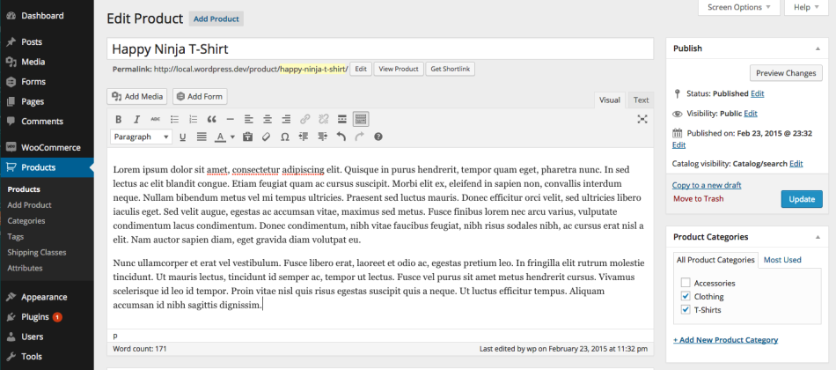
TOPIC 02 · PRODUCTS
Adding a Simple Product
Products > Add New — a familiar WordPress editing interface.
Building a Successful eCommerce Store with WooCommerce · TGS-2026064474
© 2026 Tertiary Infotech Academy Pte Ltd
57

Slide 58
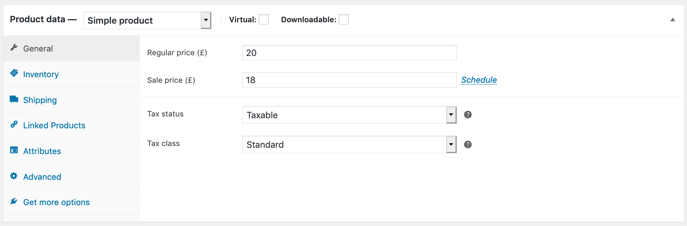
TOPIC 02 · PRODUCTS
The Product Data Panel
General, Inventory, Shipping, Linked Products, Attributes and Advanced.
Building a Successful eCommerce Store with WooCommerce · TGS-2026064474
© 2026 Tertiary Infotech Academy Pte Ltd
58

Slide 59
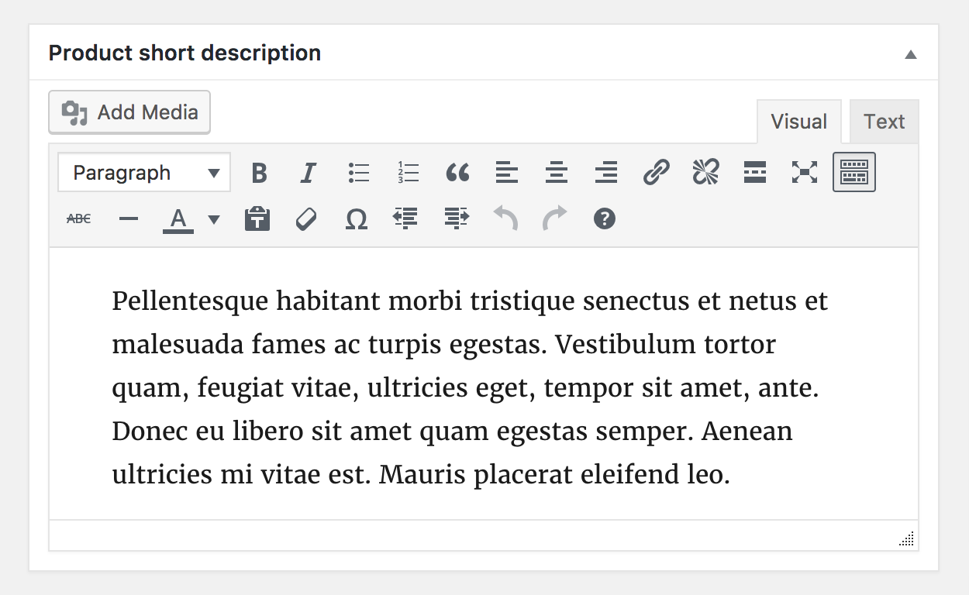
TOPIC 02 · CONTENT
Product Short Description
The excerpt beside the product image; the long description fills the Description tab.
Building a Successful eCommerce Store with WooCommerce · TGS-2026064474
© 2026 Tertiary Infotech Academy Pte Ltd
59

Slide 60
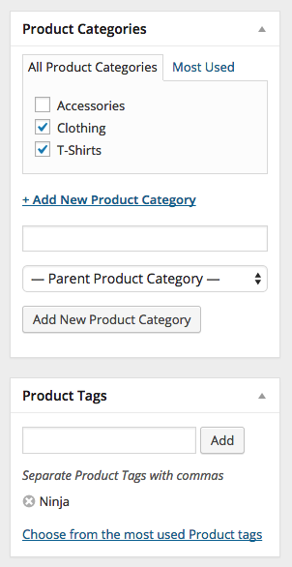
TOPIC 02 · TAXONOMIES
Product Categories and Tags
Assigned from the right-hand column, exactly like a WordPress post.
Building a Successful eCommerce Store with WooCommerce · TGS-2026064474
© 2026 Tertiary Infotech Academy Pte Ltd
60

Slide 61
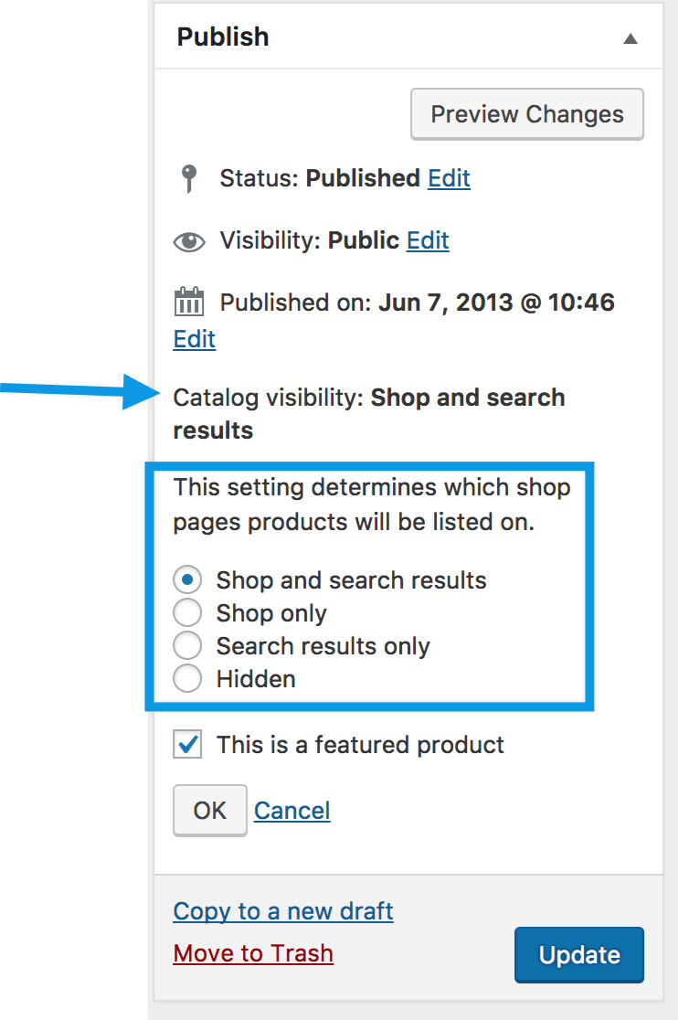
TOPIC 02 · MEDIA
Product Images and Galleries
A featured image plus a gallery — and catalogue visibility controls where it appears.
Building a Successful eCommerce Store with WooCommerce · TGS-2026064474
© 2026 Tertiary Infotech Academy Pte Ltd
61

Slide 62
TOPIC 02 · WHERE A PRODUCT APPEARS
Catalog Visibility Options
Shop and search
Visible everywhere — shop pages, category pages and search results.
Shop only
Visible in shop and category pages, but not in search results.
1
2
Search only
Visible in search results, but not in the shop or category pages.
Hidden
Only reachable on its own product page — useful for unlisted or bundled items.
3
4
Building a Successful eCommerce Store with WooCommerce · TGS-2026064474
© 2026 Tertiary Infotech Academy Pte Ltd
62

Slide 63
TOPIC 02 · HANDS-ON LAB
Create and Curate a Simple Product
LAB 2
Edit and curate product web content on the WooCommerce CMS (A6, K2, K4).
Build your first catalogue entry. You add a simple product with a title, long and short description, price and SKU, upload a featured image and a gallery, then file it under a category and tag so customers can find it. This is the core content-curation task the CMS exists to support.
YOU'LL BUILD
WHY THE BUSINESS CARES
A published simple product, complete with images, price, SKU, category and tag
Product content is the storefront's sales copy. Consistent titles, descriptions and imagery are exactly the content guidelines a CMS policy governs — and the reason curation matters.
TOOLS Products > Add New · Product Data panel · Product image & gallery · Categories · Tags
Building a Successful eCommerce Store with WooCommerce · TGS-2026064474
© 2026 Tertiary Infotech Academy Pte Ltd
63

Slide 64
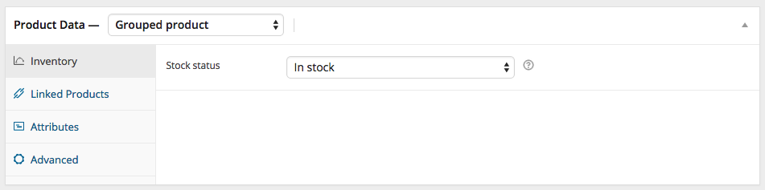
TOPIC 02 · GROUPED
Adding a Grouped Product
Select Grouped from the Product data dropdown — price fields disappear.
Building a Successful eCommerce Store with WooCommerce · TGS-2026064474
© 2026 Tertiary Infotech Academy Pte Ltd
64

Slide 65
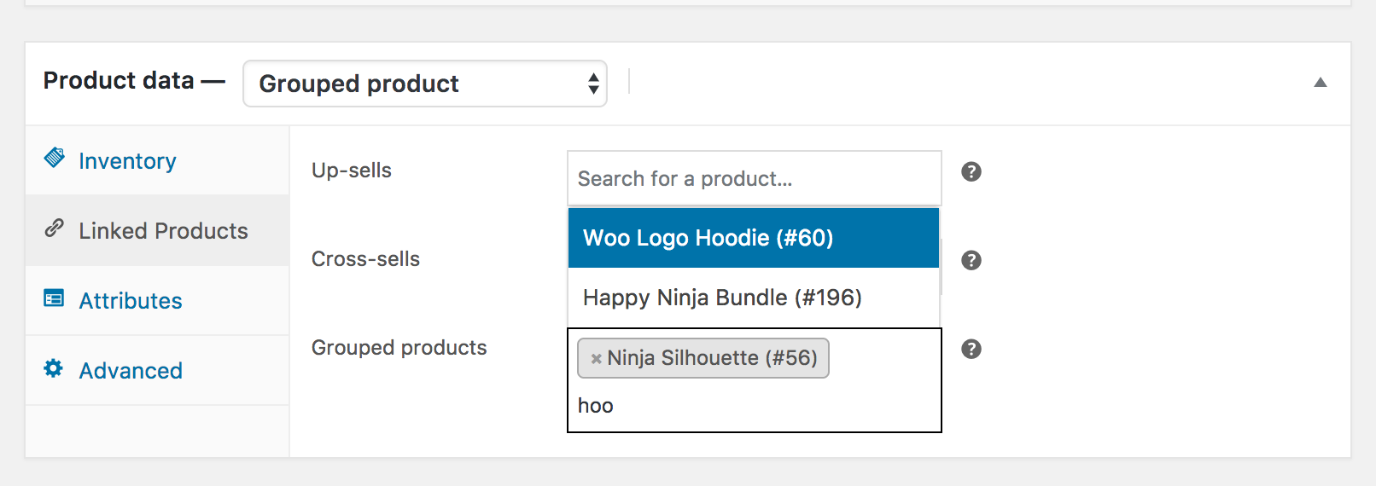
TOPIC 02 · GROUPED
Populating a Grouped Product
Add child products from Linked Products > Grouped products, then reorder by dragging.
Building a Successful eCommerce Store with WooCommerce · TGS-2026064474
© 2026 Tertiary Infotech Academy Pte Ltd
65

Slide 66
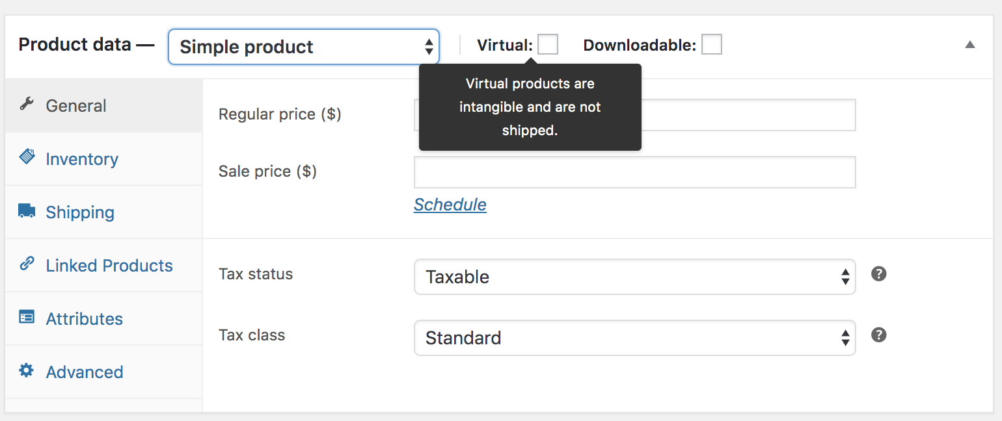
TOPIC 02 · VIRTUAL
Virtual and Downloadable Products
Tick Virtual to remove shipping; tick Downloadable to add a file path and download limit.
Building a Successful eCommerce Store with WooCommerce · TGS-2026064474
© 2026 Tertiary Infotech Academy Pte Ltd
66

Slide 67
TOPIC 02 · VARIABLE PRODUCTS
Creating a Variable Product
1
2
3
4
5
▶
▶
▶
▶
ADD ATTRIBUTE
e.g. Size, Colour
ENTER VALUES
Small | Medium | Large
USE FOR VARIATIONS
Tick the box, save
GENERATE VARIATIONS
All combinations at once
SET PRICE & STOCK
Per variation
Building a Successful eCommerce Store with WooCommerce · TGS-2026064474
© 2026 Tertiary Infotech Academy Pte Ltd
67

Slide 68
TOPIC 02 · HANDS-ON LAB
Create a Variable Product with Attributes and Variations
LAB 3
Maintain product web content that carries options, pricing and stock per variation (A4, K2, K4).
Most real products come in options. You define a custom attribute such as Size or Colour, generate the variations from it, then give each variation its own SKU, price, stock level and image — and verify the dropdowns work on the storefront.
YOU'LL BUILD
WHY THE BUSINESS CARES
A published variable product whose variations each carry their own price, SKU and stock
Variations keep one product page instead of five near-duplicates. That is cleaner content, better SEO, and far less maintenance when a price or description changes.
TOOLS Product data > Variable product · Attributes tab · Variations tab · Used for variations
Building a Successful eCommerce Store with WooCommerce · TGS-2026064474
© 2026 Tertiary Infotech Academy Pte Ltd
68

Slide 69
TOPIC 02 · ORGANISING THE CATALOGUE
Categories, Tags and Attributes
Product categories
Hierarchical — parents and subcategories, with a slug, description, display type and image.
Product tags
Flat, with no hierarchy. Use them for cross-cutting themes such as 'cat print' or 'summer'.
1
2
Product attributes
Per-product or global. Global attributes power layered navigation and variations.
The default category
Every product must have a category; unassigned products fall into 'Uncategorized'.
3
4
Building a Successful eCommerce Store with WooCommerce · TGS-2026064474
© 2026 Tertiary Infotech Academy Pte Ltd
69

Slide 70
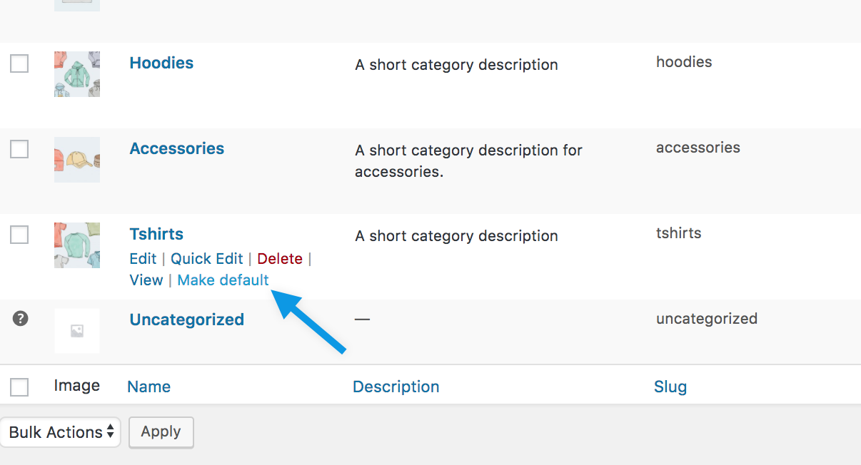
TOPIC 02 · CATEGORIES
The Default Category
'Uncategorized' cannot be deleted while it is the default — but it can be renamed or switched.
Building a Successful eCommerce Store with WooCommerce · TGS-2026064474
© 2026 Tertiary Infotech Academy Pte Ltd
70

Slide 71
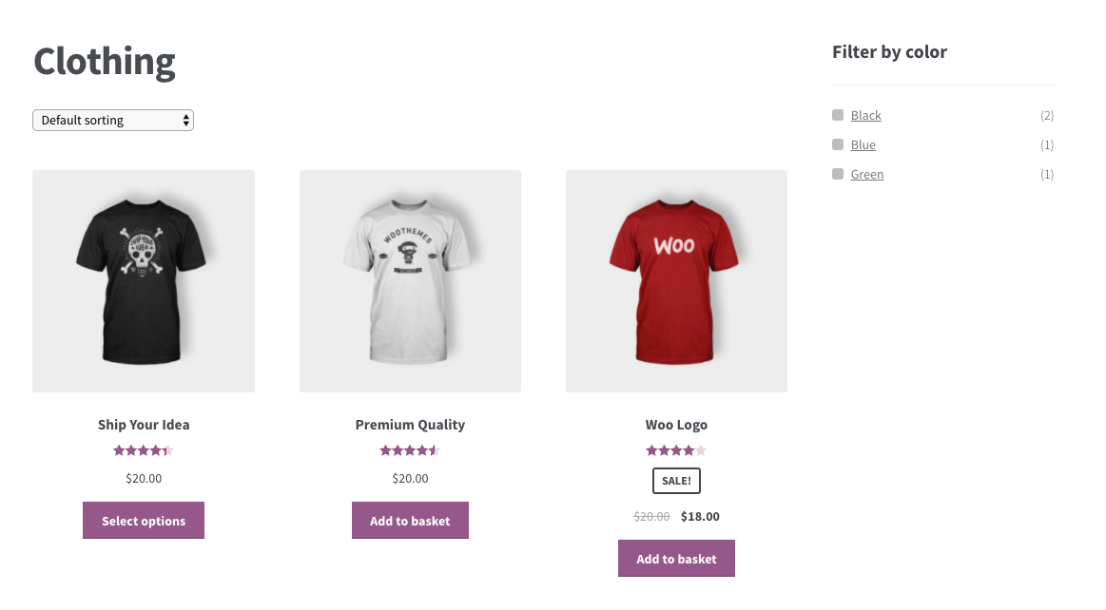
TOPIC 02 · ATTRIBUTES
Product Attributes
Attributes drive the Filter by Attribute widget and are required for variations.
Building a Successful eCommerce Store with WooCommerce · TGS-2026064474
© 2026 Tertiary Infotech Academy Pte Ltd
71

Slide 72
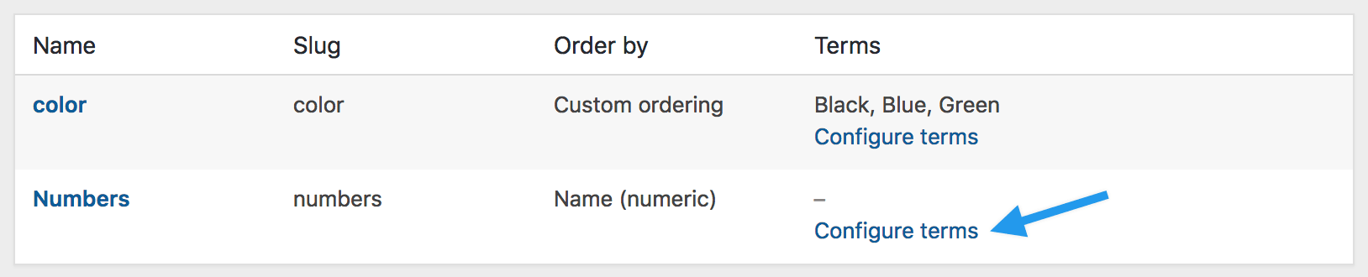
TOPIC 02 · ATTRIBUTES
Managing Global Attributes
Products > Attributes — add a name, slug, archives option and default sort order.
Building a Successful eCommerce Store with WooCommerce · TGS-2026064474
© 2026 Tertiary Infotech Academy Pte Ltd
72

Slide 73
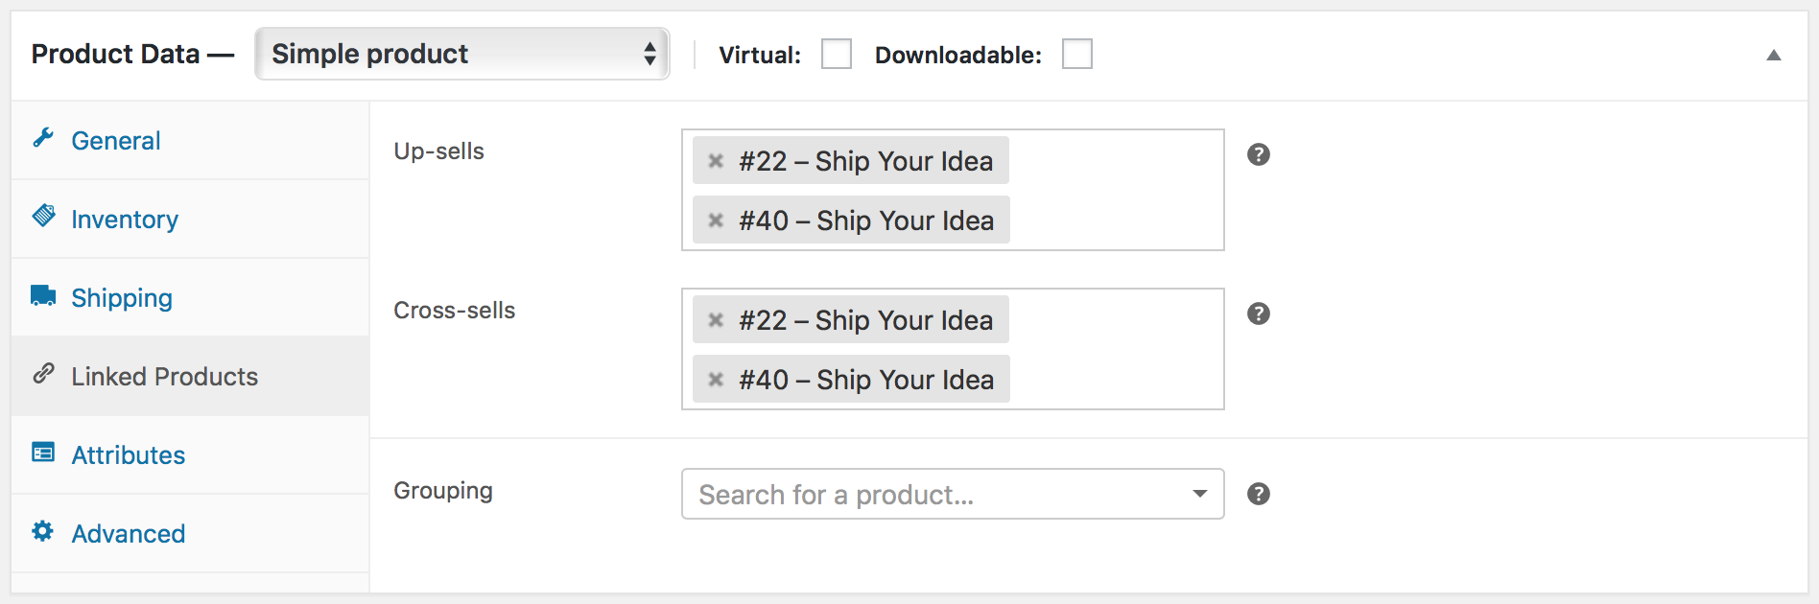
TOPIC 02 · LINKED PRODUCTS
Linked Products
Product data > Linked Products — search for the product you want to link.
Building a Successful eCommerce Store with WooCommerce · TGS-2026064474
© 2026 Tertiary Infotech Academy Pte Ltd
73

Slide 74
TOPIC 02 · RAISING ORDER VALUE
Up-Sells, Cross-Sells and Related Products
Up-sells
Cross-sells
Related products
• Shown on the PRODUCT page
• Recommended INSTEAD of this item
• Typically higher value or quality
• You choose them
• Shown in the CART
• Complementary to what's being bought
• e.g. a case with a laptop
• You choose them
• Shown on the PRODUCT page
• Chosen AUTOMATICALLY
• Shares categories or tags
• Influenced by how you categorise
Building a Successful eCommerce Store with WooCommerce · TGS-2026064474
© 2026 Tertiary Infotech Academy Pte Ltd
74

Slide 75
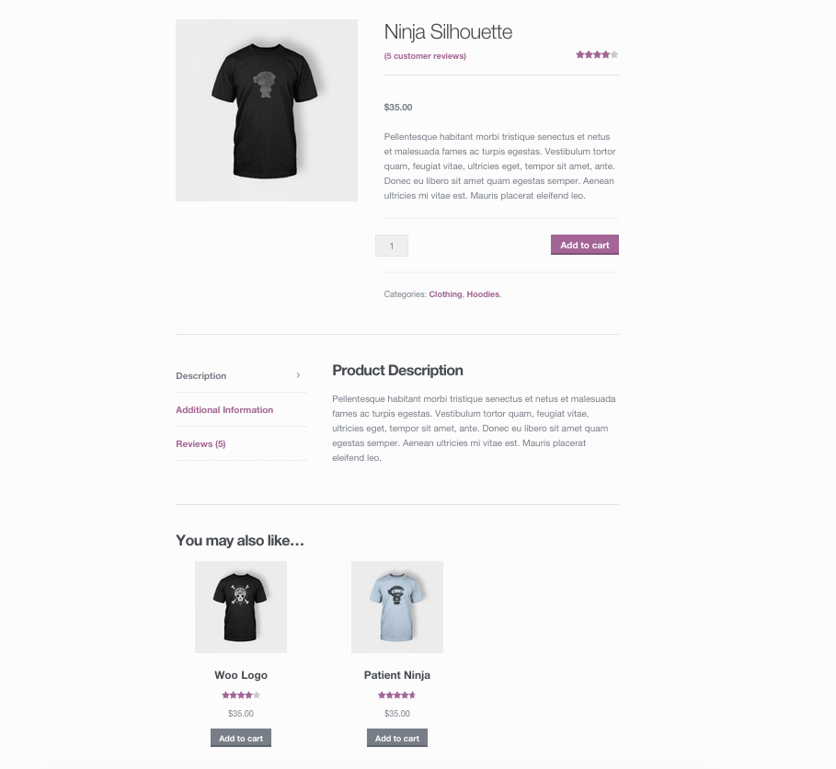
TOPIC 02 · UP-SELLS
Up-Sells on the Product Page
Up-sells display beneath the product description.
Building a Successful eCommerce Store with WooCommerce · TGS-2026064474
© 2026 Tertiary Infotech Academy Pte Ltd
75

Slide 76
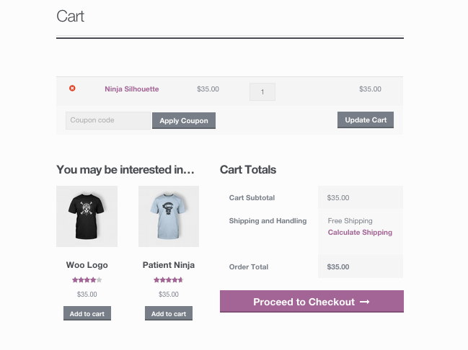
TOPIC 02 · CROSS-SELLS
Cross-Sells in the Cart
Cross-sells are promoted on the cart page, based on what is already in it.
Building a Successful eCommerce Store with WooCommerce · TGS-2026064474
© 2026 Tertiary Infotech Academy Pte Ltd
76

Slide 77
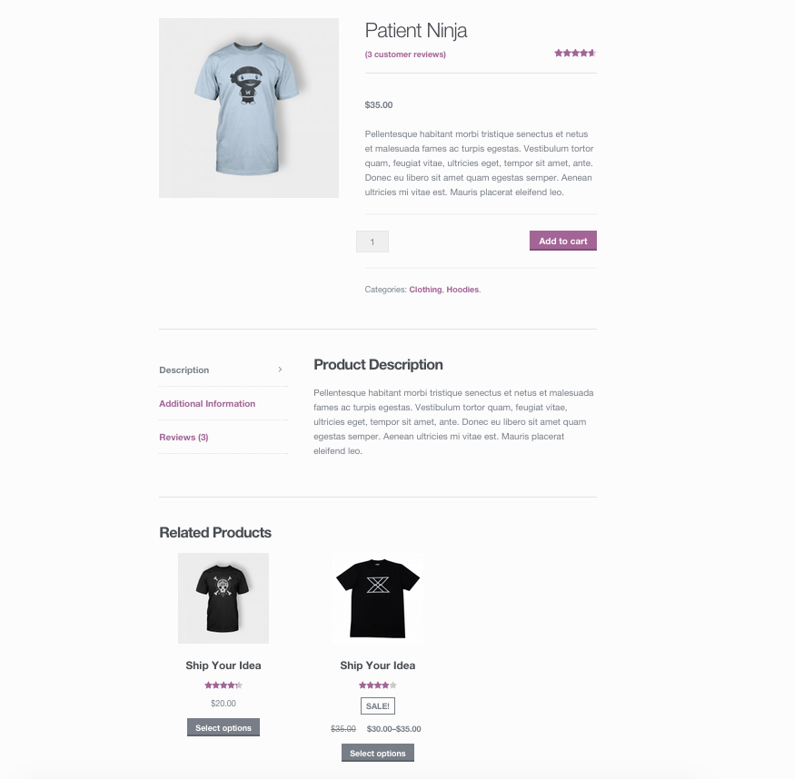
TOPIC 02 · RELATED
Related Products
Automatic — pulled from products sharing the same categories or tags.
Building a Successful eCommerce Store with WooCommerce · TGS-2026064474
© 2026 Tertiary Infotech Academy Pte Ltd
77

Slide 78
TOPIC 02 · BULK MAINTENANCE
Product CSV Importer and Exporter
Built in
Included since WooCommerce 3.1 — no plugin required.
Every product type
Supports simple, grouped, external and variable products, including variations.
1
2
For new stores
Export a template, fill it in, and launch a whole catalogue in one pass.
For existing stores
Update hundreds of products, run a sale, or sync multiple storefronts.
3
4
Building a Successful eCommerce Store with WooCommerce · TGS-2026064474
© 2026 Tertiary Infotech Academy Pte Ltd
78

Slide 79
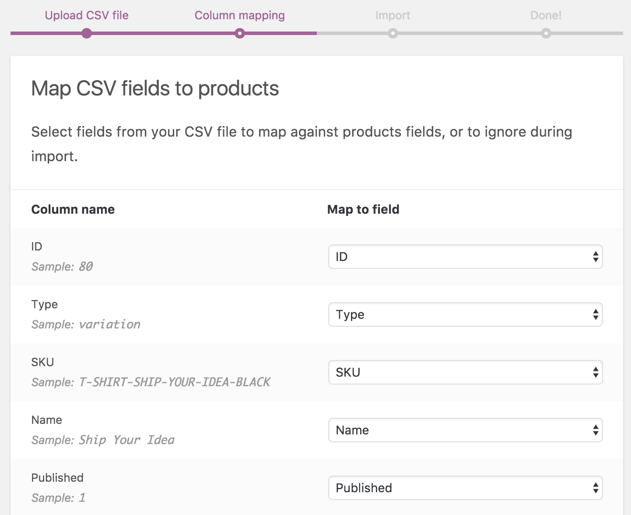
TOPIC 02 · CSV IMPORT
Importing Products
Products > Import > choose your CSV > Continue > map columns > Run the importer.
Building a Successful eCommerce Store with WooCommerce · TGS-2026064474
© 2026 Tertiary Infotech Academy Pte Ltd
79

Slide 80
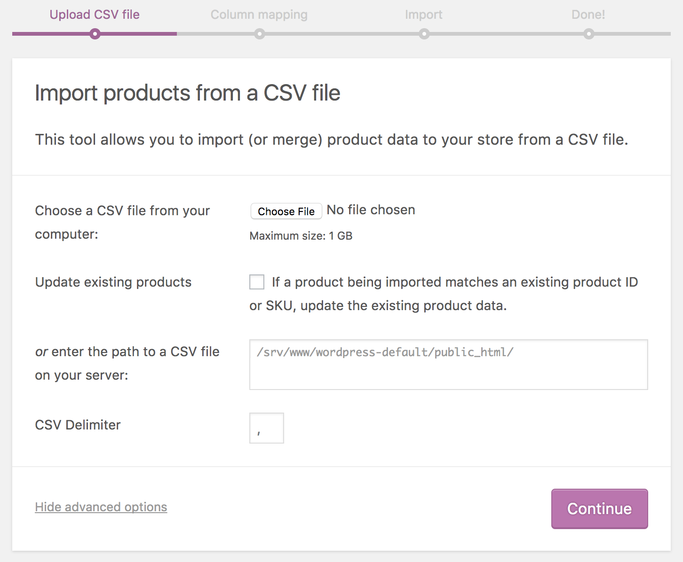
TOPIC 02 · CSV IMPORT
Mapping CSV Columns
WooCommerce proposes a column mapping — review it before running the importer.
Building a Successful eCommerce Store with WooCommerce · TGS-2026064474
© 2026 Tertiary Infotech Academy Pte Ltd
80

Slide 81
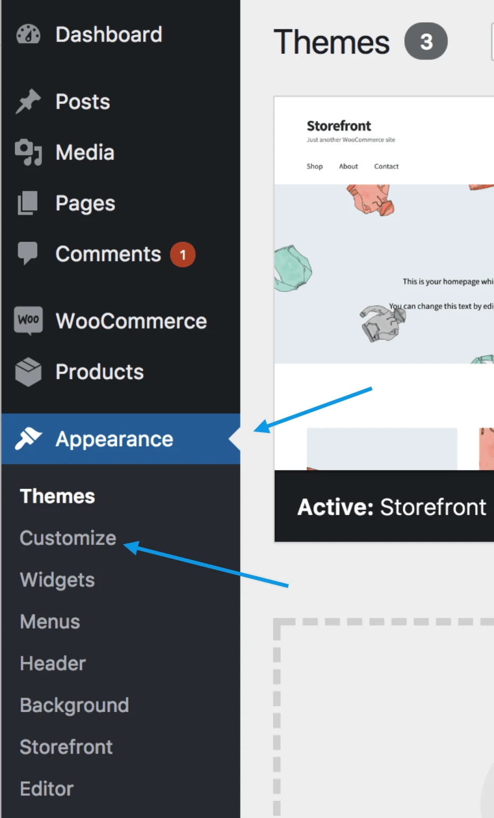
TOPIC 02 · CUSTOMIZER
The WooCommerce Customizer
Appearance > Customize > WooCommerce — Store Notice, Product Catalog and Product Images.
Building a Successful eCommerce Store with WooCommerce · TGS-2026064474
© 2026 Tertiary Infotech Academy Pte Ltd
81

Slide 82
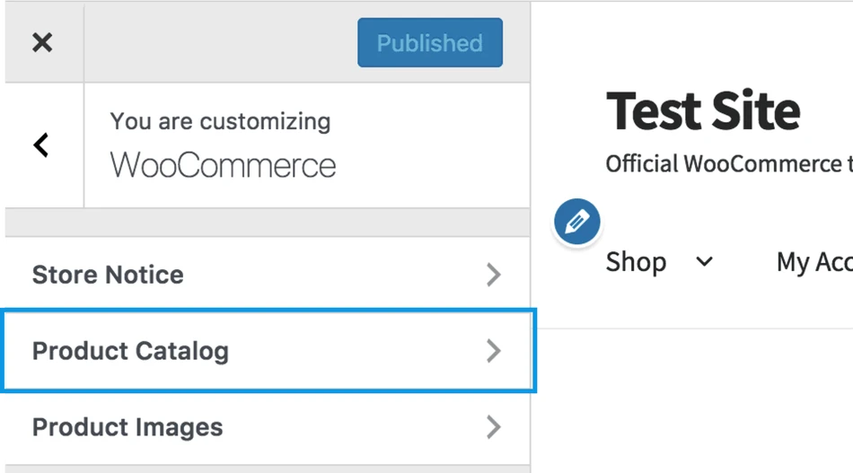
TOPIC 02 · CUSTOMIZER
Product Catalog Options
Appearance > Customize > WooCommerce > Product Catalog.
Building a Successful eCommerce Store with WooCommerce · TGS-2026064474
© 2026 Tertiary Infotech Academy Pte Ltd
82

Slide 83
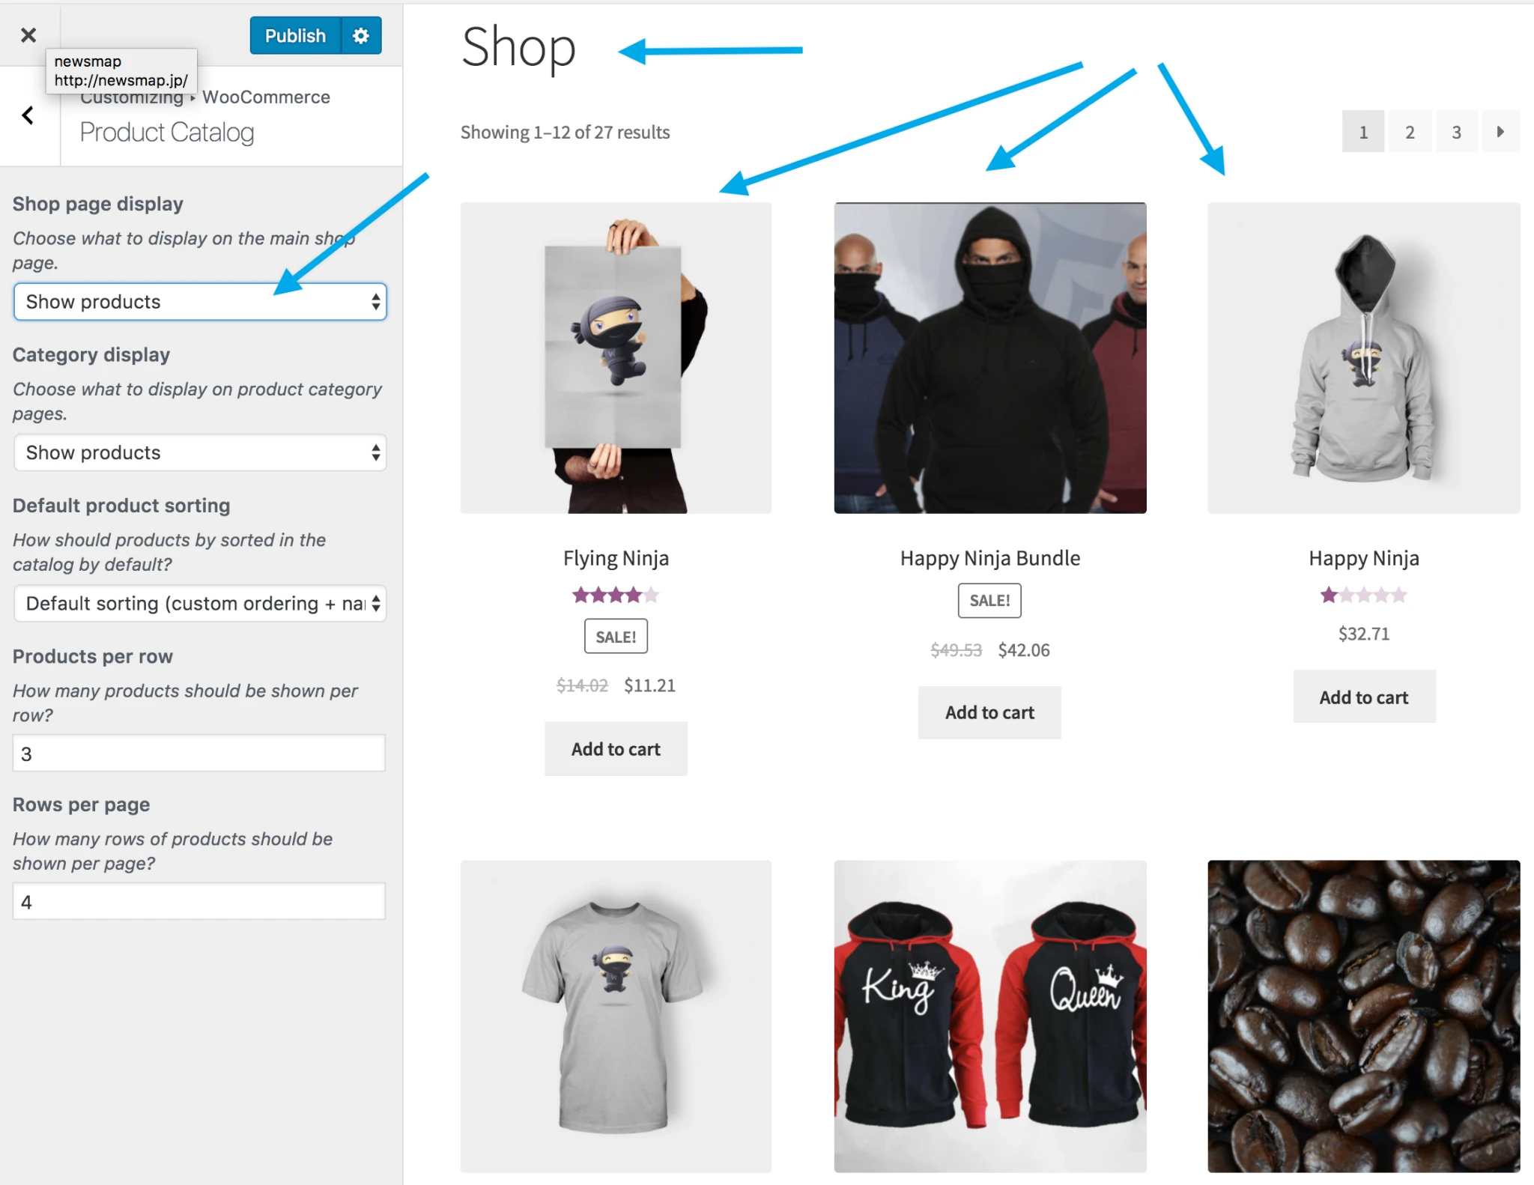
TOPIC 02 · CUSTOMIZER
The Shop Page
Display Products, Categories, or both — one choice gives the cleanest look.
Building a Successful eCommerce Store with WooCommerce · TGS-2026064474
© 2026 Tertiary Infotech Academy Pte Ltd
83

Slide 84
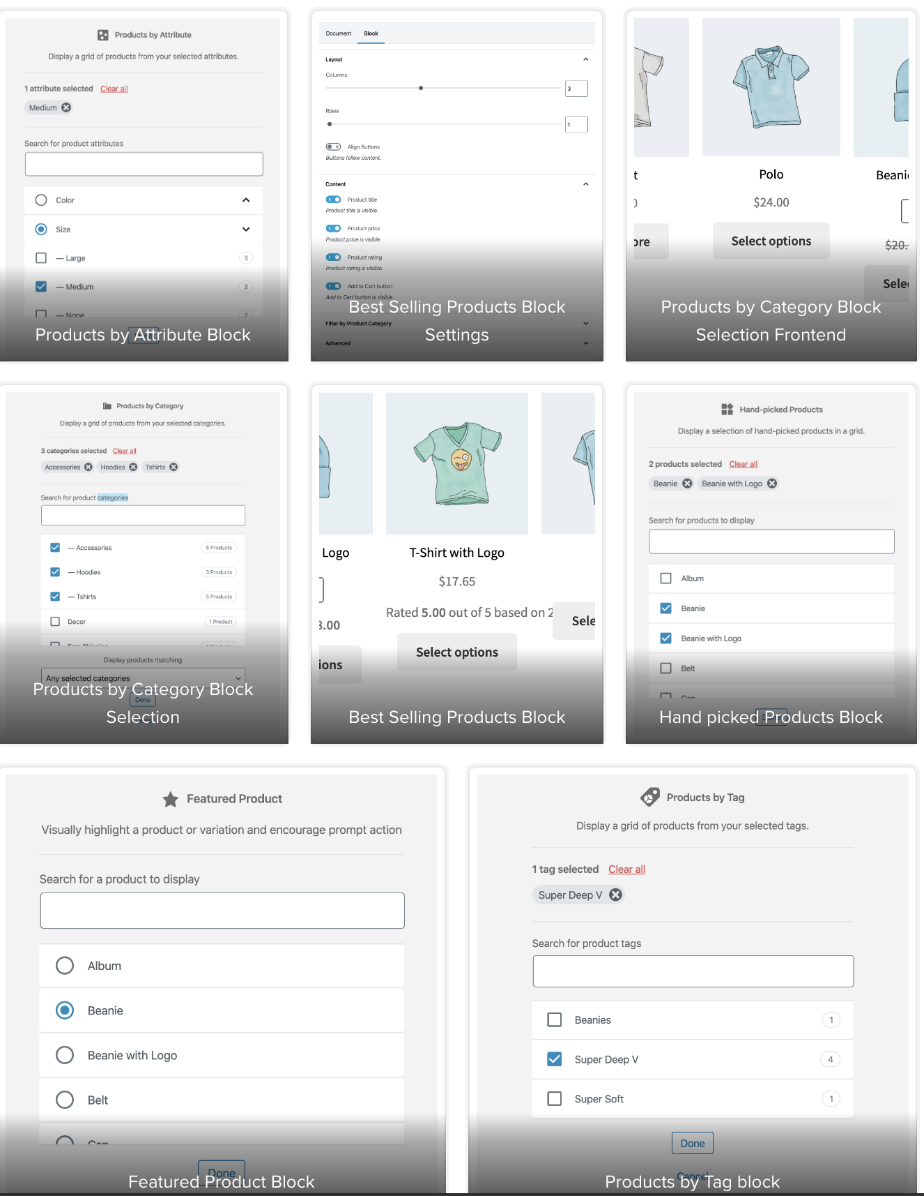
TOPIC 02 · BLOCKS
WooCommerce Blocks
Product blocks for any post or page — by tag, category, attribute, best selling, on sale and more.
Building a Successful eCommerce Store with WooCommerce · TGS-2026064474
© 2026 Tertiary Infotech Academy Pte Ltd
84

Slide 85
TOPIC 02 · HANDS-ON LAB
Curate the Catalogue — Linked Products and CSV Import
LAB 4
Ensure smooth maintenance and consistent bulk updates of the product catalogue (A4, K2, K4).
Grow and maintain the catalogue efficiently. You organise categories and global attributes, link products together as up-sells and cross-sells to raise order value, then import a batch of products from a CSV file and export the catalogue for bulk editing.
YOU'LL BUILD
WHY THE BUSINESS CARES
A curated catalogue with categories, attributes, up-sells, cross-sells and CSV-imported products
Editing products one at a time does not scale. Bulk import and export is how a real store launches a catalogue, runs a seasonal price change, or syncs with a supplier feed.
TOOLS Products > Categories · Products > Attributes · Linked Products tab · Product CSV Importer/Exporter
Building a Successful eCommerce Store with WooCommerce · TGS-2026064474
© 2026 Tertiary Infotech Academy Pte Ltd
85

Slide 86
03
TOPIC 3
Manage Payments and Shipping
Online & offline payment methods · Gateways · Shipping zones · Flat rate, free shipping & local pickup
Building a Successful eCommerce Store with WooCommerce · TGS-2026064474
© 2026 Tertiary Infotech Academy Pte Ltd
86

Slide 87
TOPIC 03 · WHAT YOU'LL LEARN
Key Concepts in This Topic
Payment methods
Online gateways such as Stripe and PayPal, plus offline options like bank transfer, cheque and cash on delivery.
Choosing a gateway
Location, fees, supported currencies and whether the customer stays on your site all shape the decision.
1
2
Shipping zones
A zone is a geographic region; each zone carries its own shipping methods and rates.
Flat rate shipping
A standard cost per order, per item or per shipping class, defined inside a shipping zone.
3
4
Free shipping
A powerful incentive — commonly gated behind a minimum order amount or a valid coupon.
Local pickup
Lets the customer collect the order themselves, with optional cost and tax status.
5
6
Building a Successful eCommerce Store with WooCommerce · TGS-2026064474
© 2026 Tertiary Infotech Academy Pte Ltd
87

Slide 88
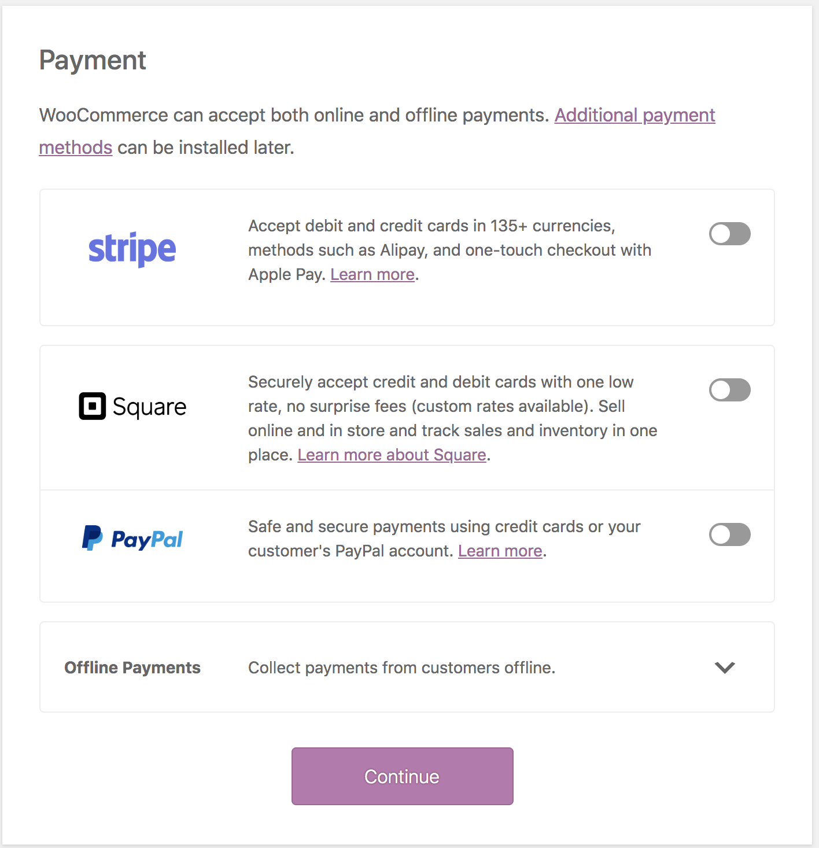
TOPIC 03 · PAYMENTS
Online Payment Methods
Card and wallet gateways that take payment at checkout.
Building a Successful eCommerce Store with WooCommerce · TGS-2026064474
© 2026 Tertiary Infotech Academy Pte Ltd
88

Slide 89
TOPIC 03 · ONLINE GATEWAYS
Choosing a Payment Gateway
Stripe
Supports 25+ countries and recurring payments; the customer stays on your site.
PayPal
Active in 200+ countries, with PayPal Credit available for US stores.
1
2
Square
Suits merchants who also sell in person, in a physical store.
eWAY
Takes card payments directly on your store without redirecting the customer.
3
4
Klarna
Buy-now-pay-later across Europe, the UK and the US.
Payfast
A popular South African gateway for card and EFT, with no monthly cost.
5
6
Building a Successful eCommerce Store with WooCommerce · TGS-2026064474
© 2026 Tertiary Infotech Academy Pte Ltd
89

Slide 90
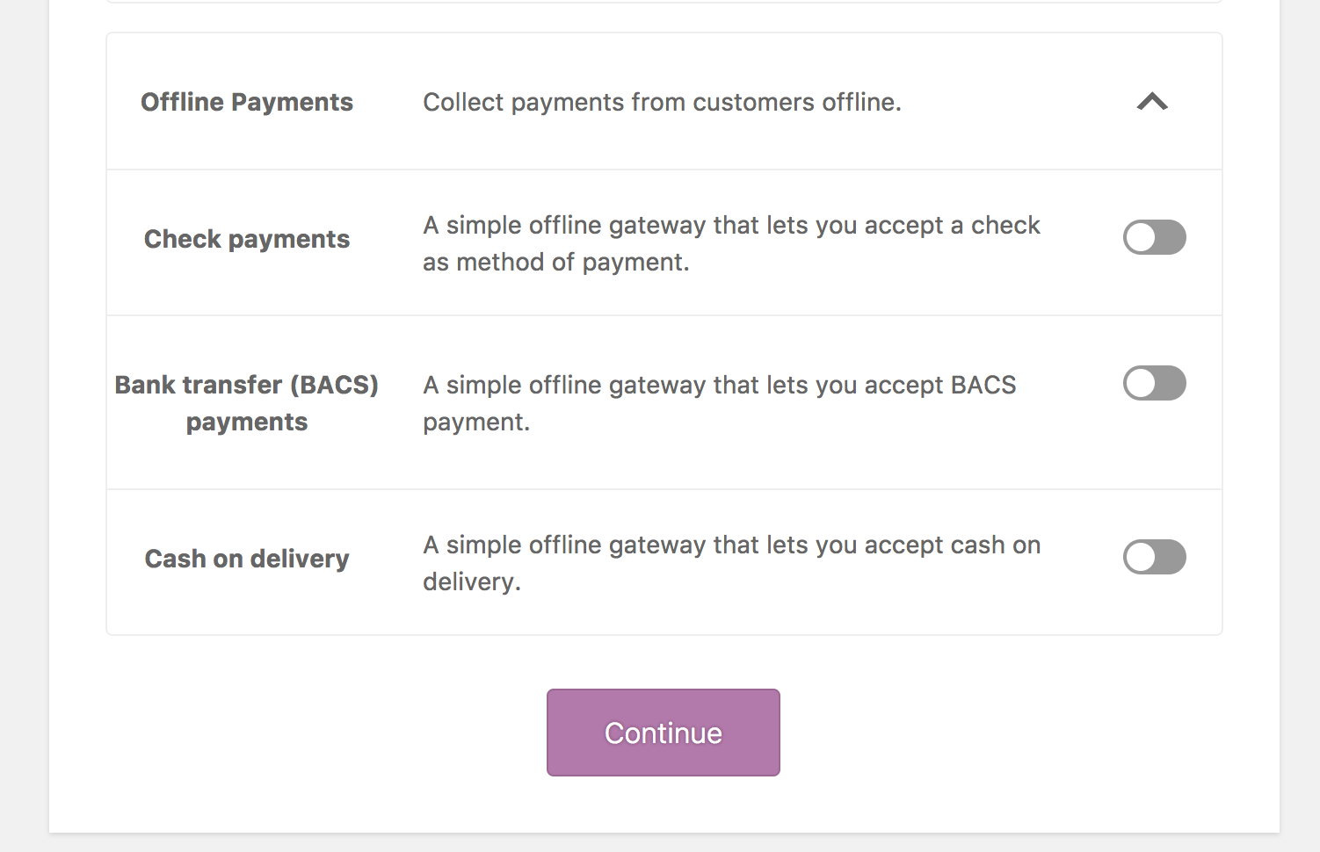
TOPIC 03 · PAYMENTS
Offline Payment Methods
Direct bank transfer, cheque and cash on delivery — the order is held until you confirm payment.
Building a Successful eCommerce Store with WooCommerce · TGS-2026064474
© 2026 Tertiary Infotech Academy Pte Ltd
90

Slide 91
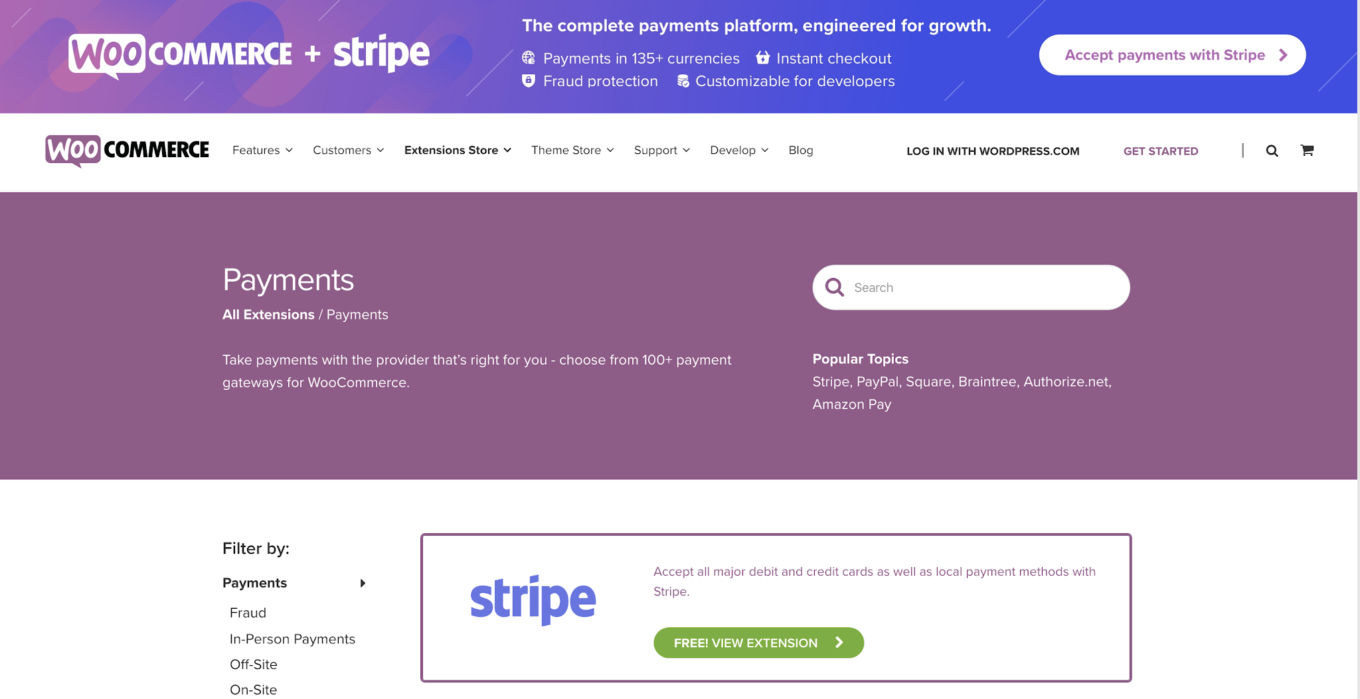
TOPIC 03 · PAYMENTS
Additional Payment Gateways
https://woocommerce.com/product-category/woocommerce-extensions/payment-gateways
Building a Successful eCommerce Store with WooCommerce · TGS-2026064474
© 2026 Tertiary Infotech Academy Pte Ltd
91

Slide 92
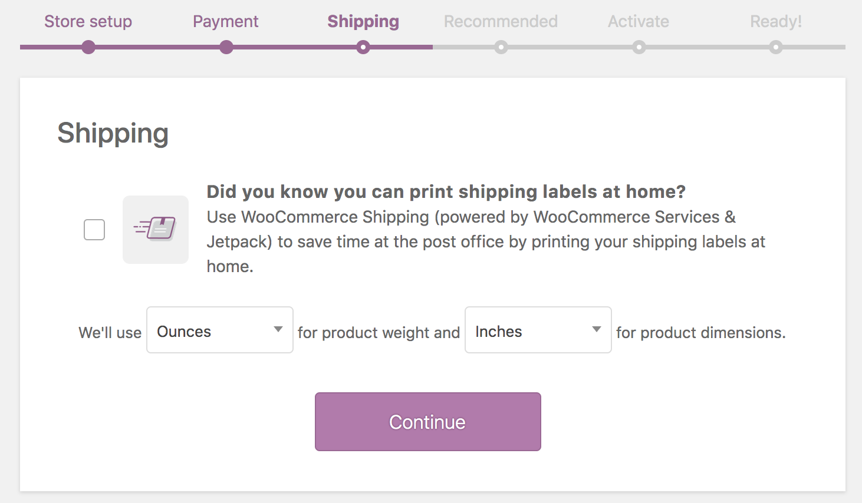
TOPIC 03 · SHIPPING
Shipping Options
Set the unit of measurement for weight and dimensions before configuring rates.
Building a Successful eCommerce Store with WooCommerce · TGS-2026064474
© 2026 Tertiary Infotech Academy Pte Ltd
92

Slide 93
TOPIC 03 · SHIPPING ZONES
How Shipping Is Structured
1
2
3
4
5
▶
▶
▶
▶
SHIPPING ZONE
A geographic region
SHIPPING METHOD
Flat rate, free, pickup
METHOD SETTINGS
Title, tax status, cost
SHIPPING CLASS
Optional per-product rate
CHECKOUT
Customer picks an option
Building a Successful eCommerce Store with WooCommerce · TGS-2026064474
© 2026 Tertiary Infotech Academy Pte Ltd
93

Slide 94
TOPIC 03 · WHAT'S BUILT IN
Core Shipping Options
Flat rate
A standard cost per order, per item or per shipping class.
Free shipping
Optionally gated behind a minimum order amount or a valid coupon.
1
2
Local pickup
The customer collects the order themselves, with optional cost.
Shipping classes
Group products that cost more to ship — bulky, fragile or heavy items.
3
4
Building a Successful eCommerce Store with WooCommerce · TGS-2026064474
© 2026 Tertiary Infotech Academy Pte Ltd
94

Slide 95
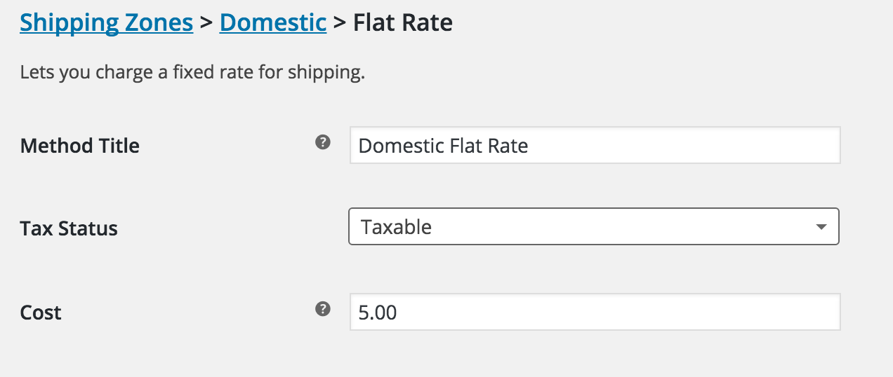
TOPIC 03 · SHIPPING
Flat Rate Shipping
Added to a shipping zone, with a title, tax status and cost applied to the cart.
Building a Successful eCommerce Store with WooCommerce · TGS-2026064474
© 2026 Tertiary Infotech Academy Pte Ltd
95

Slide 96
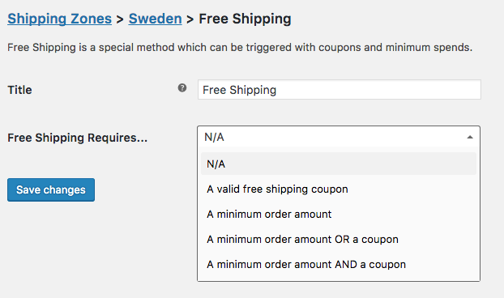
TOPIC 03 · SHIPPING
Free Shipping
'Free shipping requires…' — commonly a minimum order amount, to lift average order value.
Building a Successful eCommerce Store with WooCommerce · TGS-2026064474
© 2026 Tertiary Infotech Academy Pte Ltd
96

Slide 97
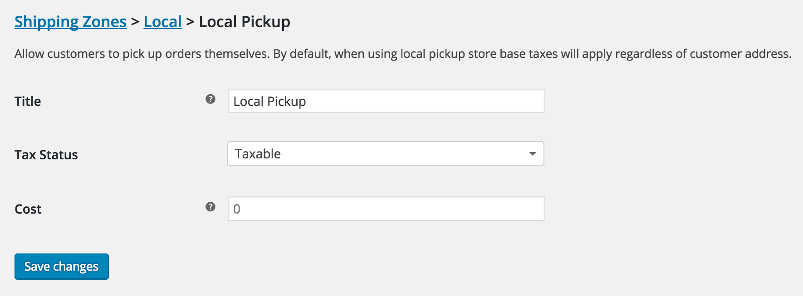
TOPIC 03 · SHIPPING
Local Pickup
Let customers collect the order — some stores retitle this 'Collect in store'.
Building a Successful eCommerce Store with WooCommerce · TGS-2026064474
© 2026 Tertiary Infotech Academy Pte Ltd
97

Slide 98
TOPIC 03 · HANDS-ON LAB
Configure Payment Methods and Shipping Zones
LAB 5
Recommend and configure payment and shipping methods that improve customer experience (A3, K3).
Make the store able to take money and deliver goods. You enable offline and online payment methods, then build a shipping zone for your country and add flat rate, free shipping and local pickup to it — finishing with a test checkout that proves the whole path works.
YOU'LL BUILD
WHY THE BUSINESS CARES
A store that accepts payment and offers three shipping options, verified by a test checkout
Payment and shipping are where carts are abandoned. Every method you offer, and every rate you set, is a direct customer-experience decision with a measurable effect on conversion.
TOOLS WooCommerce > Settings > Payments · Settings > Shipping · Shipping zones · Shipping classes
Building a Successful eCommerce Store with WooCommerce · TGS-2026064474
© 2026 Tertiary Infotech Academy Pte Ltd
98

Slide 99
TOPIC 03 · DISCUSSION
Discussion — Recommend Payment and Shipping for Customer Experience
DISCUSSION · 15 MIN
Working from the store you have built, recommend the payment and shipping mix that would give your customers the best experience — and justify the trade-offs.
1
2
3
4
Which payment methods do your customers expect, and what does each one cost you?
Does the customer stay on your site, or get redirected? Why does that matter for conversion?
Would free shipping above a threshold raise your average order value or erode your margin?
Which shipping zones do you actually serve, and what happens to orders outside them?
YOUR OUTPUT A recommended payment and shipping configuration with the customer-experience reason for each choice.
Building a Successful eCommerce Store with WooCommerce · TGS-2026064474
© 2026 Tertiary Infotech Academy Pte Ltd
99

Slide 100
04
TOPIC 4
Manage Sales on WooCommerce Store
Orders & order statuses · Editing single orders · Refunds & restocking · Coupons and promotions
Building a Successful eCommerce Store with WooCommerce · TGS-2026064474
© 2026 Tertiary Infotech Academy Pte Ltd
100

Slide 101
TOPIC 04 · WHAT YOU'LL LEARN
Key Concepts in This Topic
Orders and statuses
Pending, Processing, Completed, On-Hold, Cancelled, Refunded and Failed track an order's life.
Managing orders
View, filter and edit orders; change status, edit line items, add fees and apply coupons.
1
2
Adding orders manually
Phone and offline sales can be entered by hand and emailed to the customer for payment.
Refunds
Refund manually or through the gateway, with the option to restock the returned items.
3
4
Stock issues
Stock management, low-stock thresholds and out-of-stock handling prevent overselling.
Coupons and promotions
Percentage, fixed cart and fixed product discounts, with usage limits and expiry dates.
5
6
Building a Successful eCommerce Store with WooCommerce · TGS-2026064474
© 2026 Tertiary Infotech Academy Pte Ltd
101

Slide 102
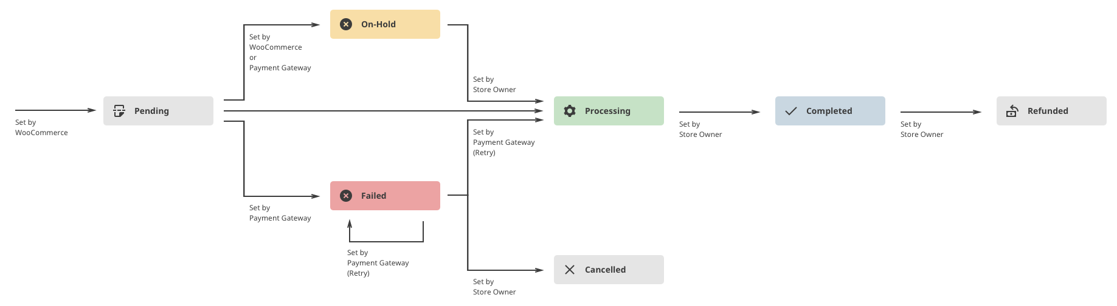
TOPIC 04 · ORDERS
Managing Orders
An order is created at checkout, gets a unique ID, and carries a status through its life.
Building a Successful eCommerce Store with WooCommerce · TGS-2026064474
© 2026 Tertiary Infotech Academy Pte Ltd
102

Slide 103
TOPIC 04 · THE LIFE OF AN ORDER
Order Statuses
Pending payment
Order received, no payment initiated — unpaid.
Processing
Payment received and stock reduced; awaiting fulfilment.
1
2
Completed
Order fulfilled — no further action required.
On hold
Stock is reduced, but you must confirm payment yourself.
3
4
Cancelled
Cancelled by admin or customer — stock is increased back.
Refunded / Failed
Refunded by an admin, or payment declined or requiring authentication.
5
6
Building a Successful eCommerce Store with WooCommerce · TGS-2026064474
© 2026 Tertiary Infotech Academy Pte Ltd
103

Slide 104
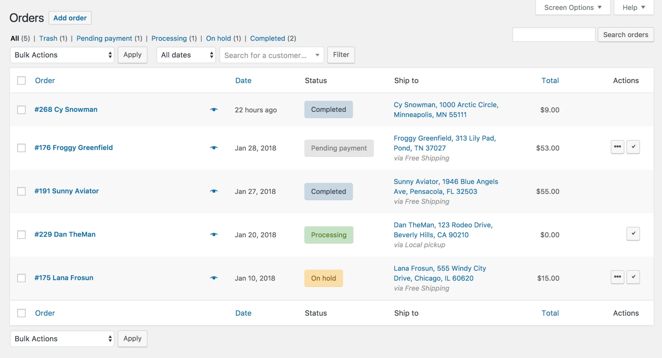
TOPIC 04 · ORDERS
Viewing Orders
WooCommerce > Orders — number, customer, date, status, address and total.
Building a Successful eCommerce Store with WooCommerce · TGS-2026064474
© 2026 Tertiary Infotech Academy Pte Ltd
104

Slide 105
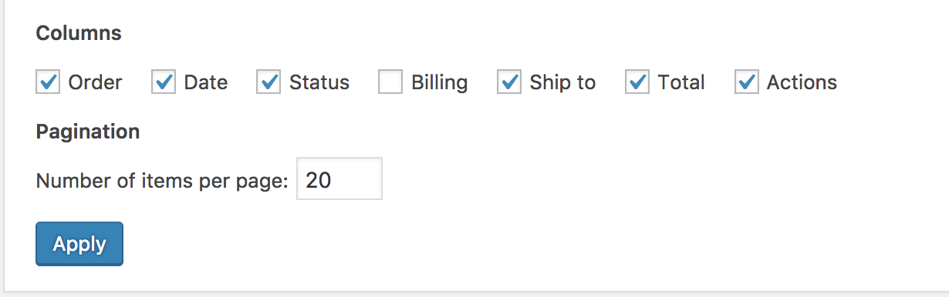
TOPIC 04 · ORDERS
Screen Options and Filtering
Choose columns and rows, filter by date, search customers, and preview with the 'eye'.
Building a Successful eCommerce Store with WooCommerce · TGS-2026064474
© 2026 Tertiary Infotech Academy Pte Ltd
105

Slide 106
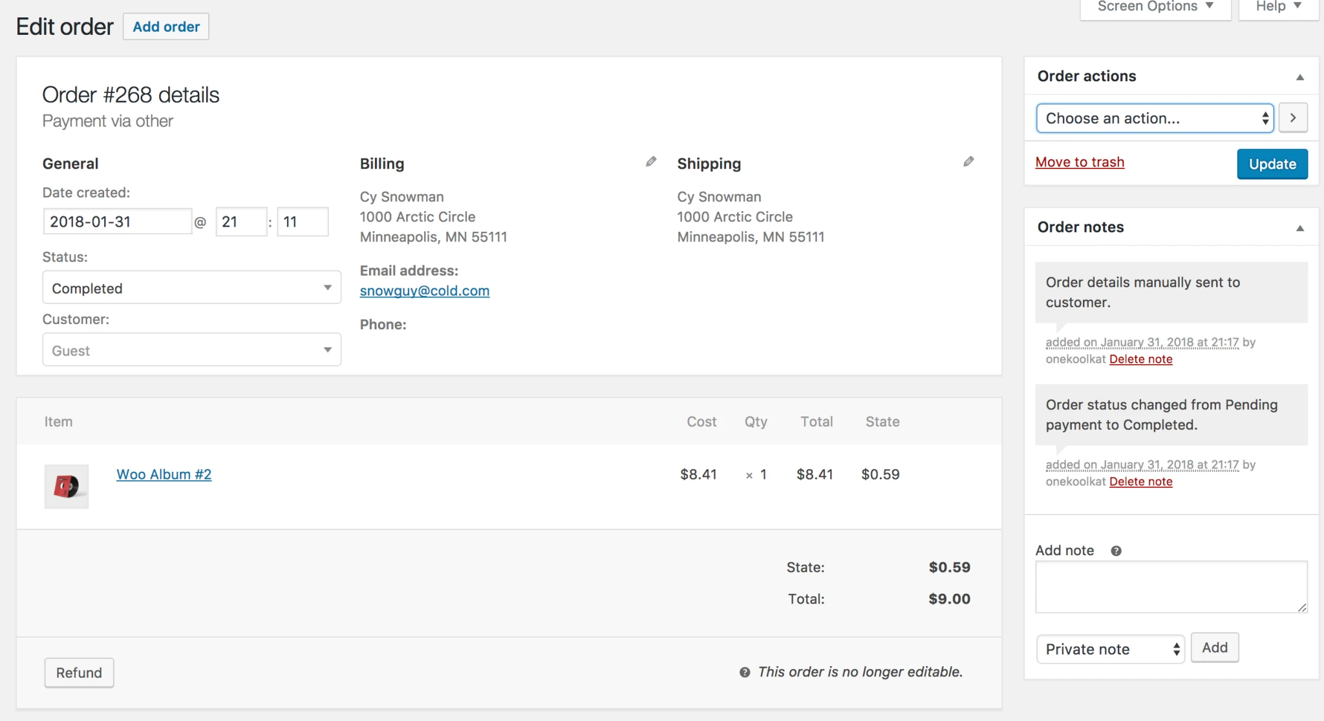
TOPIC 04 · ORDERS
The Single Order Page
View and edit everything — status, line items, taxes, coupons, fees and notes.
Building a Successful eCommerce Store with WooCommerce · TGS-2026064474
© 2026 Tertiary Infotech Academy Pte Ltd
106

Slide 107
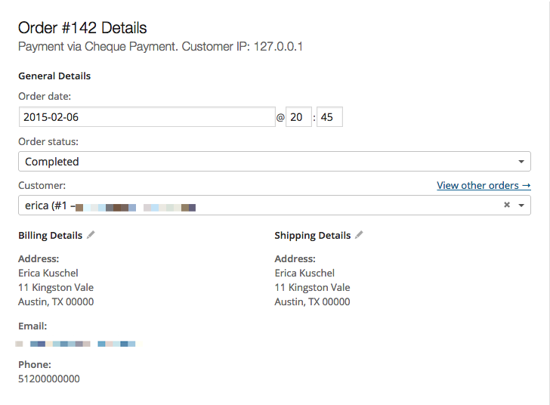
TOPIC 04 · ORDERS
Order Data Panel
Modify the status, the customer note, and which user the order is assigned to.
Building a Successful eCommerce Store with WooCommerce · TGS-2026064474
© 2026 Tertiary Infotech Academy Pte Ltd
107

Slide 108
TOPIC 04 · WHAT YOU CAN CHANGE
Editing a Single Order
Change status
Move the order through its lifecycle and trigger the customer emails.
Edit order items
Modify products, quantities, prices and taxes on an unpaid order.
1
2
Stock
Reduce or restore stock for the order directly from Order actions.
Apply coupons
Enter a known coupon code — the order must be unpaid for it to take effect.
3
4
Add a fee
Enter an amount or a percentage; negative fees apportion tax across items.
Order actions
Email order details to the customer, or regenerate download permissions.
5
6
Building a Successful eCommerce Store with WooCommerce · TGS-2026064474
© 2026 Tertiary Infotech Academy Pte Ltd
108

Slide 109
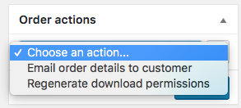
TOPIC 04 · ORDERS
Adding an Order Manually
WooCommerce > Orders > Add order — for phone and offline sales.
Building a Successful eCommerce Store with WooCommerce · TGS-2026064474
© 2026 Tertiary Infotech Academy Pte Ltd
109

Slide 110
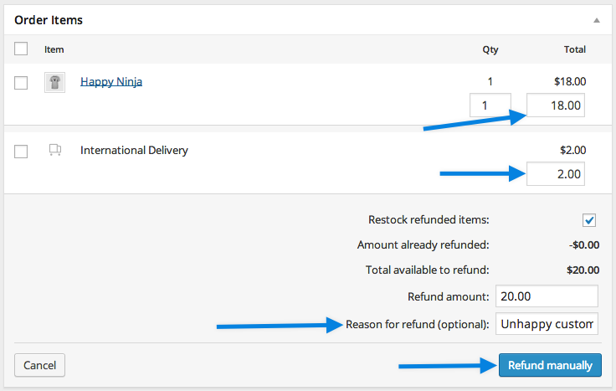
TOPIC 04 · REFUNDS
Refunding an Order
Open the order, click Refund, enter the amount and a reason, then Refund manually.
Building a Successful eCommerce Store with WooCommerce · TGS-2026064474
© 2026 Tertiary Infotech Academy Pte Ltd
110

Slide 111
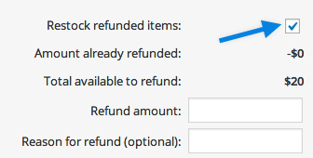
TOPIC 04 · REFUNDS
Restocking Refunded Items
Tick 'Restock refunded items' so returned stock goes back into inventory.
Building a Successful eCommerce Store with WooCommerce · TGS-2026064474
© 2026 Tertiary Infotech Academy Pte Ltd
111

Slide 112

TOPIC 04 · COUPONS
Adding a Coupon
Marketing > Coupons > Add coupon — enter or generate a unique code.
Building a Successful eCommerce Store with WooCommerce · TGS-2026064474
© 2026 Tertiary Infotech Academy Pte Ltd
112

Slide 113

TOPIC 04 · COUPONS
Coupon Discount Settings
Discount type and amount, free shipping, and an expiry date.
Building a Successful eCommerce Store with WooCommerce · TGS-2026064474
© 2026 Tertiary Infotech Academy Pte Ltd
113

Slide 114
TOPIC 04 · GET THE ARITHMETIC RIGHT
The Three Discount Types
Percentage discount
A share off the qualifying items. 3 shirts at $20 = $60; 10% off gives $6.
Fixed cart discount
A flat sum off the whole cart. 3 shirts at $20 = $60; $10 off gives $10.
1
2
Fixed product discount
A set amount off EACH qualifying item. 3 shirts, $10 off each, gives $30.
Restrictions & limits
Minimum spend, product and category limits, usage limit per coupon and per user.
3
4
Building a Successful eCommerce Store with WooCommerce · TGS-2026064474
© 2026 Tertiary Infotech Academy Pte Ltd
114

Slide 115
TOPIC 04 · HANDS-ON LAB
Process Orders, Refunds and Coupons
LAB 6
Highlight and resolve issues related to sales, stock, refunds and promotions (A5, K5).
Run the store as a shop manager. You walk an order through its statuses, edit and manually create orders, issue a refund that restocks the item, then build a coupon and prove it applies at checkout — the day-to-day issue resolution the CMS is used for.
YOU'LL BUILD
WHY THE BUSINESS CARES
A processed order, a completed refund with restocking, and a working discount coupon
Orders, refunds and promotions are where customer problems surface. Resolving them quickly and correctly — with stock and revenue staying accurate — is the operational heart of the store.
TOOLS WooCommerce > Orders · Order statuses · Refund · WooCommerce > Coupons · Checkout
Building a Successful eCommerce Store with WooCommerce · TGS-2026064474
© 2026 Tertiary Infotech Academy Pte Ltd
115

Slide 116
05
TOPIC 5
Manage WooCommerce Performance
Sales reports · Customer & stock reports · Dashboard widgets · eCommerce metrics · Google Analytics
Building a Successful eCommerce Store with WooCommerce · TGS-2026064474
© 2026 Tertiary Infotech Academy Pte Ltd
116

Slide 117
TOPIC 05 · WHAT YOU'LL LEARN
Key Concepts in This Topic
WooCommerce Reports
Orders, Customers, Stock and Taxes — the built-in view of how the store is performing.
Sales reports
Gross and net sales by date, product and category, plus top sellers, top earners and coupon usage.
1
2
Customer and stock reports
Customers versus guests, and low-stock, out-of-stock and on-backorder items.
Dashboard widgets
At-a-glance store status on the WordPress dashboard, configurable through Screen Options.
3
4
eCommerce metrics
Conversion rate, traffic, revenue by source, retention, repeat purchase and refund rate.
Google Analytics
Integrating analytics attributes revenue to channels and shows where customers drop off.
5
6
Building a Successful eCommerce Store with WooCommerce · TGS-2026064474
© 2026 Tertiary Infotech Academy Pte Ltd
117

Slide 118

TOPIC 05 · REPORTS
WooCommerce Reports
WooCommerce > Reports — Orders, Customers, Stock and Taxes.
Building a Successful eCommerce Store with WooCommerce · TGS-2026064474
© 2026 Tertiary Infotech Academy Pte Ltd
118

Slide 119

TOPIC 05 · REPORTS
Order Reports
Sales by date, by product, by category, coupons by date and customer downloads.
Building a Successful eCommerce Store with WooCommerce · TGS-2026064474
© 2026 Tertiary Infotech Academy Pte Ltd
119

Slide 120

TOPIC 05 · REPORTS
Customer Reports
Customers vs. Guests, and the customer list — sortable across time periods.
Building a Successful eCommerce Store with WooCommerce · TGS-2026064474
© 2026 Tertiary Infotech Academy Pte Ltd
120

Slide 121

TOPIC 05 · REPORTS
Stock Reports
Low in stock, out of stock, and most stocked — lost revenue you can prevent.
Building a Successful eCommerce Store with WooCommerce · TGS-2026064474
© 2026 Tertiary Infotech Academy Pte Ltd
121

Slide 122

TOPIC 05 · DASHBOARD
Dashboard Widgets
WooCommerce adds status widgets to the WordPress dashboard; tune them via Screen Options.
Building a Successful eCommerce Store with WooCommerce · TGS-2026064474
© 2026 Tertiary Infotech Academy Pte Ltd
122

Slide 123
TOPIC 05 · WHAT TO MEASURE · K6, K7
Metrics for a Successful Store
Sales & revenue
Gross and net sales, revenue by traffic source, and average order value.
Conversion
Sales conversion rate — the share of visitors who actually buy.
1
2
Traffic
Website traffic and organic acquisition traffic.
Engagement
Email click-through rate, email subscription rate and social media engagement.
3
4
Loyalty
Customer retention rate and repeat customer rate.
Problems
Refund and return rate, and customer enquiries.
5
6
Building a Successful eCommerce Store with WooCommerce · TGS-2026064474
© 2026 Tertiary Infotech Academy Pte Ltd
123

Slide 124
TOPIC 05 · CHOOSING WHAT TO TRACK · K7
Criteria for Evaluating a Metric
Actionable
Does a change in this number tell somebody to do something differently?
Comparable
Can you track it consistently over time and against a target?
1
2
Attributable
Can you tell which channel, campaign or product caused the movement?
Owned
Is there a person responsible for it, and a threshold that triggers a response?
3
4
Building a Successful eCommerce Store with WooCommerce · TGS-2026064474
© 2026 Tertiary Infotech Academy Pte Ltd
124

Slide 125

TOPIC 05 · EXTENDING
WooCommerce Extensions
https://woocommerce.com/product-category/woocommerce-extensions/
Building a Successful eCommerce Store with WooCommerce · TGS-2026064474
© 2026 Tertiary Infotech Academy Pte Ltd
125

Slide 126

TOPIC 05 · EXTENDING
Recommended Free Plugins
WooCommerce Admin, Mailchimp for WooCommerce, Facebook for WooCommerce and Automated Taxes.
Building a Successful eCommerce Store with WooCommerce · TGS-2026064474
© 2026 Tertiary Infotech Academy Pte Ltd
126

Slide 127

TOPIC 05 · ANALYTICS
Google Analytics Integration
https://wordpress.org/plugins/woocommerce-google-analytics-integration/
Building a Successful eCommerce Store with WooCommerce · TGS-2026064474
© 2026 Tertiary Infotech Academy Pte Ltd
127

Slide 128

TOPIC 05 · EXTENDING
Subscriptions
Recurring revenue — https://woocommerce.com/products/woocommerce-subscriptions/
Building a Successful eCommerce Store with WooCommerce · TGS-2026064474
© 2026 Tertiary Infotech Academy Pte Ltd
128

Slide 129

TOPIC 05 · EXTENDING
Bookings
Sell time and appointments — https://woocommerce.com/products/woocommerce-bookings/
Building a Successful eCommerce Store with WooCommerce · TGS-2026064474
© 2026 Tertiary Infotech Academy Pte Ltd
129

Slide 130

TOPIC 05 · EXTENDING
Memberships
Gate content and offers — https://woocommerce.com/products/woocommerce-memberships/
Building a Successful eCommerce Store with WooCommerce · TGS-2026064474
© 2026 Tertiary Infotech Academy Pte Ltd
130

Slide 131
TOPIC 05 · HANDS-ON LAB
Measure Store Performance with Reports and Analytics
LAB 7
Develop and review metrics to measure the performance of the store (A2, K6, K7).
Turn the store's activity into evidence. You read the Orders, Customers, Stock and Taxes reports, arrange the dashboard widgets a manager would want, install the Google Analytics integration, and select the handful of metrics you would actually use to judge whether the store is succeeding.
YOU'LL BUILD
WHY THE BUSINESS CARES
A reviewed set of store reports, a configured dashboard, and a defined list of performance metrics
Metrics are only useful if they change a decision. Choosing which few to track — and knowing what each one would tell you — is what separates a measured store from a busy one.
TOOLS WooCommerce > Reports · Analytics · Dashboard widgets · Screen Options · Google Analytics plugin
Building a Successful eCommerce Store with WooCommerce · TGS-2026064474
© 2026 Tertiary Infotech Academy Pte Ltd
131

Slide 132
TOPIC 05 · DISCUSSION
Discussion — Metrics to Measure Store Performance
DISCUSSION · 15 MIN
Decide which metrics you would use to judge whether the store is succeeding, and what criteria make a metric worth tracking at all.
1
2
3
4
Which three metrics would you put in front of the business owner every week?
What makes a metric useful — is it actionable, comparable, and tied to a decision?
What does a rising refund rate or a falling repeat-customer rate actually tell you?
Which report or tool produces each metric — WooCommerce Reports or Google Analytics?
YOUR OUTPUT A shortlist of performance metrics with the criteria used to select them and their data source.
Building a Successful eCommerce Store with WooCommerce · TGS-2026064474
© 2026 Tertiary Infotech Academy Pte Ltd
132

Slide 133
WRAP-UP
Course Summary & Next Steps
Building a Successful eCommerce Store with WooCommerce · TGS-2026064474
© 2026 Tertiary Infotech Academy Pte Ltd
133

Slide 134
LEARNING OUTCOMES
What You Achieved
1
LO1 · Setup and monitor
Installed WooCommerce, applied a theme, and set currency, tax and permissions.
2
LO2 · Edit and curate
Created products with descriptions, images, galleries, categories and tags.
3
LO3 · Maintain content
Built variable products and bulk-updated the catalogue by CSV.
4
LO4 · Payments & shipping
Configured gateways and a shipping zone with three delivery options.
5
LO5 · Manage issues
Processed orders, issued a refund with restocking, and ran a coupon promotion.
6
LO6 · Manage performance
Read the sales, customer and stock reports and defined a metric set.
Building a Successful eCommerce Store with WooCommerce · TGS-2026064474
© 2026 Tertiary Infotech Academy Pte Ltd
134

Slide 135
AFTER TODAY
Your Next Steps
Keep building your store
Your WooCommerce site and catalogue stay yours after the course.
Launch with a real product
Pick one product, price it properly, and take a real order.
1
2
Revisit the Learner Guide
Every lab's step-by-step instructions are there for you to repeat.
Explore the documentation
Official guides at https://woocommerce.com/documentation/
3
4
Building a Successful eCommerce Store with WooCommerce · TGS-2026064474
© 2026 Tertiary Infotech Academy Pte Ltd
135

Slide 136
CONTINUE YOUR LEARNING
Recommended Courses
Search Engine Optimization (SEO)
Enhance brand awareness and drive organic traffic to your new store.
Email Campaigns with Mailchimp
Turn your customer list into repeat revenue with high-converting campaigns.
1
2
Professional Websites with WordPress
Deepen the CMS skills underneath WooCommerce.
SEO for Small and Medium Enterprises
Practical search optimisation scoped to an SME budget.
3
4
Business Innovation with Blockchain
Explore emerging technology for commerce and payments.
Full catalogue
Browse everything at www.tertiarycourses.com.sg
5
6
Building a Successful eCommerce Store with WooCommerce · TGS-2026064474
© 2026 Tertiary Infotech Academy Pte Ltd
136

Slide 137
SUMMARY
Summary & Q&A
The platform
WooCommerce turns WordPress into a complete, fully customisable online store.
The content
Products, categories, attributes and variations are what you curate and maintain.
1
2
The commerce
Payments and shipping are customer-experience decisions that shape conversion.
The operations
Orders, refunds and coupons are the day-to-day issues a store manager resolves.
3
4
The evidence
Reports and analytics tell you whether any of it is actually working.
Over to you
Any questions before the assessment?
5
6
Building a Successful eCommerce Store with WooCommerce · TGS-2026064474
© 2026 Tertiary Infotech Academy Pte Ltd
137

Slide 138
ASSESSMENT · 90 MINUTES TOTAL
Final Assessment
Practical Performance — 75 min
Oral Questioning — 15 min
Before you begin
• Build and manage a WooCommerce store
• Assesses abilities A1–A6
• Open book, done individually
• Open-ended questions, 1:1
• Assesses knowledge K1–K7
• Open book
• Take the Assessment digital attendance
• Complete the TRAQOM survey
• Slides + Learner Guide allowed
• Submit as directed by your assessor
Building a Successful eCommerce Store with WooCommerce · TGS-2026064474
© 2026 Tertiary Infotech Academy Pte Ltd
138

Slide 139
ON ASSESSMENT DAY
Assessment Flow
1
2
3
4
5
6
▶
▶
▶
▶
▶
TRAQOM survey — scan the QR code on the LMS
Assessment digital attendance — scan the SSG QR
Complete the Practical Performance — 75 min
Answer the Oral Questioning — 15 min, 1:1
Submit your work as directed
Sign the Assessment Summary Record
Building a Successful eCommerce Store with WooCommerce · TGS-2026064474
© 2026 Tertiary Infotech Academy Pte Ltd
139

Slide 140
TRAQOM · SSG DIGITAL ATTENDANCE
Digital Attendance & TRAQOM Survey (Mandatory)
Assessment attendance
Take the Assessment digital attendance before you begin — scan the SSG QR code.
Cert & TRAQOM survey
Complete the mandatory survey at https://lms-tms.tertiaryinfotech.com/
1
2
Your certificate
Your certificate is issued through the LMS once you are assessed Competent.
75% minimum
At least 75% attendance is required to be eligible for assessment and funding.
3
4
Building a Successful eCommerce Store with WooCommerce · TGS-2026064474
© 2026 Tertiary Infotech Academy Pte Ltd
140

Slide 141
WE'RE HERE TO HELP — DURING AND AFTER THE CLASS
Support
Email
enquiry@tertiaryinfotech.com
Telephone
+65 6100 0613
1
2
Website
www.tertiarycourses.com.sg
LMS / TMS portal
https://lms-tms.tertiaryinfotech.com
3
4
Building a Successful eCommerce Store with WooCommerce · TGS-2026064474
© 2026 Tertiary Infotech Academy Pte Ltd
141

Slide 142
SEE YOU AT THE NEXT COURSE
Thank You!
You can now build, run and measure a complete eCommerce store with WooCommerce.
Building a Successful eCommerce Store with WooCommerce · TGS-2026064474
© 2026 Tertiary Infotech Academy Pte Ltd
142

